Slide 1
A simple, robust and adaptable strategy for ballistic landings on small binary bodies.

Slide 2
An increased interest for binary asteroids
Discovery mission proposal BASiX
ESA Cosmic Vision Marco Polo R.
P.I. Dr Daniel Scheeres
P.I. Dr A. Barucci & Dr P. Michel
We need robust ways for delivering unpowered landers to the surface of asteroids, while ensuring the safety of the mothership.

Slide 3
Summary of the Presentation
System Description
System Description
Feasibility of Strategy
Landing From L2
Grounding the Lander
Strategy Design
Jacobi integral
e.g. 1999 KW4
0-Velocity surfaces
Periapses maps
R.T.O.
Manifold deliveries
Release margins
Conley criterion
Linearizing

Slide 4
The exemple: 1999 KW4
System Description
Binary asteroid system:
Alpha (1.5km)
Beta (500m prolate) tidally-locked with Alpha
Mutual orbit parameters:
a = 2.5km
e = 0
Extensively studied
Representative of binaries (and very similar to 1996 FG3)

Slide 5
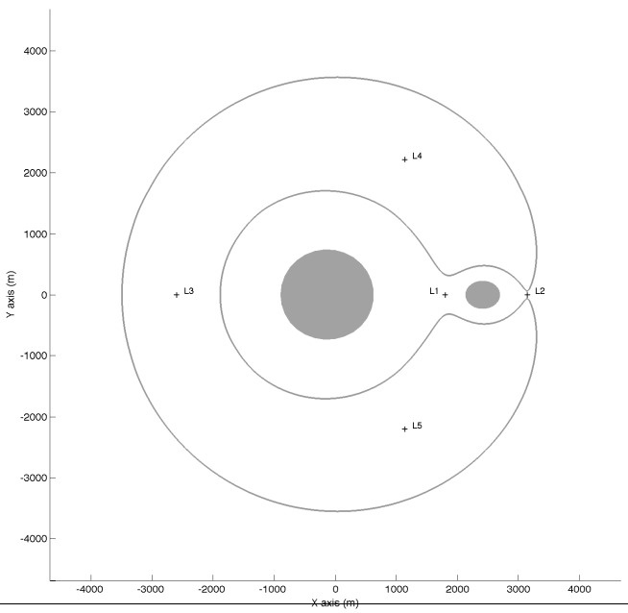
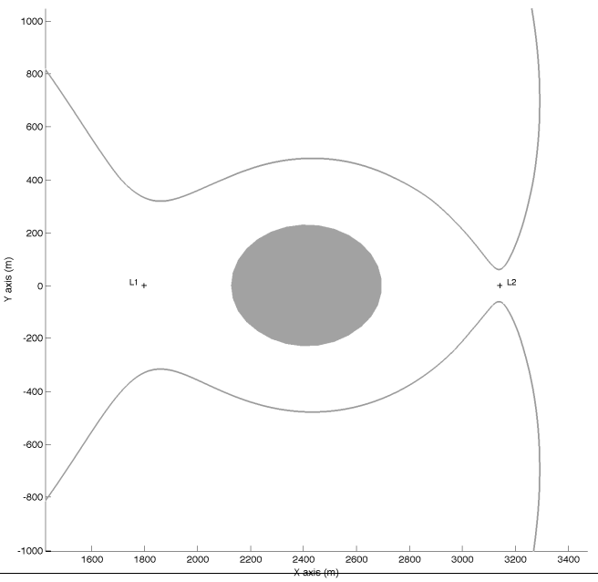
Zero-Velocity Surfaces
System Description
The ZVS separate accessible and forbidden zone of state space

Slide 6
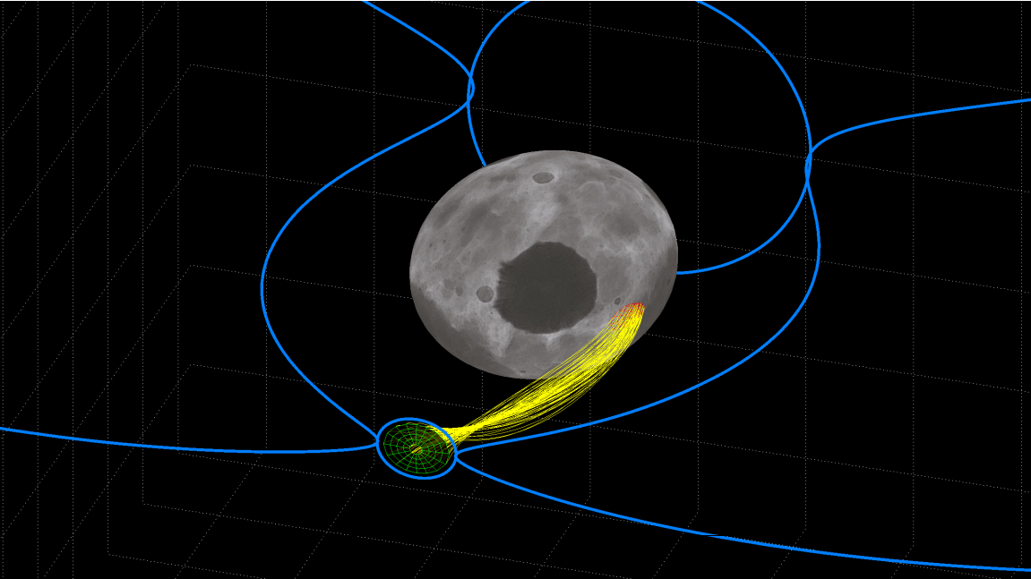
A typical trajectory bundle
Strategy Design
ALPHA 1.1 mile
Outline of the 0VS
Landing Only
L1
Beta
Landing Zone
Zone of Lander Deployment
Trajectories from L2
L2

Slide 7
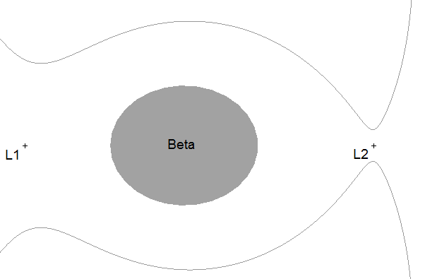
Our landing strategy
Strategy Design
ALPHA 1.1 mile
Phase 1: L2 Approach
Phase 2: Ballistic Trajectory
Phase 3: Bounces

Slide 8
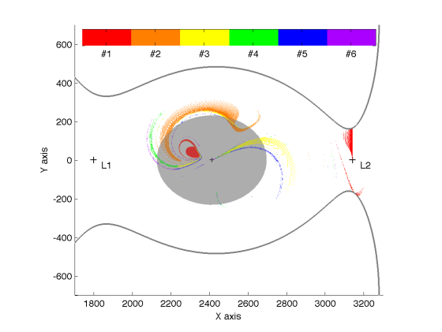
Introducing periapses Poincaré maps
Feasibility
An acceptable landing trajectory is defined as
a trajectory whose 1st periapsis lies under the asteroid surface.

Slide 9
The shape of the first periapsis region
Feasibility
The 1st periapsis region grows with energy

Slide 10
Manifold deliveries and RTO
Feasibility
Problem has too many variables:
Mass fraction µ
Energy C
Shape and size of the asteroid
RTO : Radius-To-Orbit ratio is the radius in normalized units (e.g. , 6.9% for 1999 KW4)
Manifold delivery reduces to two variables: µ and RTO.
If 1st periapsis<RTO then OK for some range of C
If 1st periapsis>RTO then dangerous for any range of C

Slide 11
Feasibility of the strategy
Feasibility
Landing on the primary (Alpha)
Landing on the secondary (Beta)
If your secondary fits above this line, the strategy works!

Slide 12
Aiming at the asteroid
Landing from L2
All trajectories that enter the secondary’s region will impact…
… how can we ensure that our lander will enter this region ?
Following Conley (1968), linearizing at L2, we obtain a criterion on the polar angle of velocity at the neck.

Slide 13
A representation of Conley’s criterion
Landing from L2

Slide 14
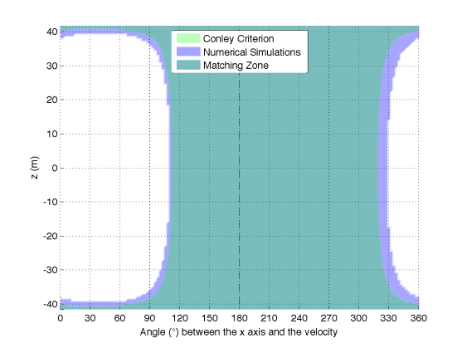
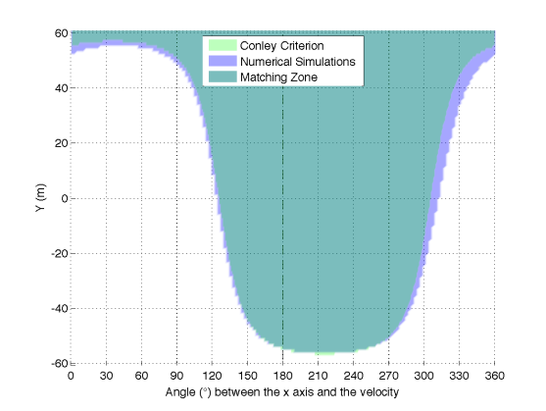
Matching analytics with simulations
Landing from L2
60m
180°

Slide 15
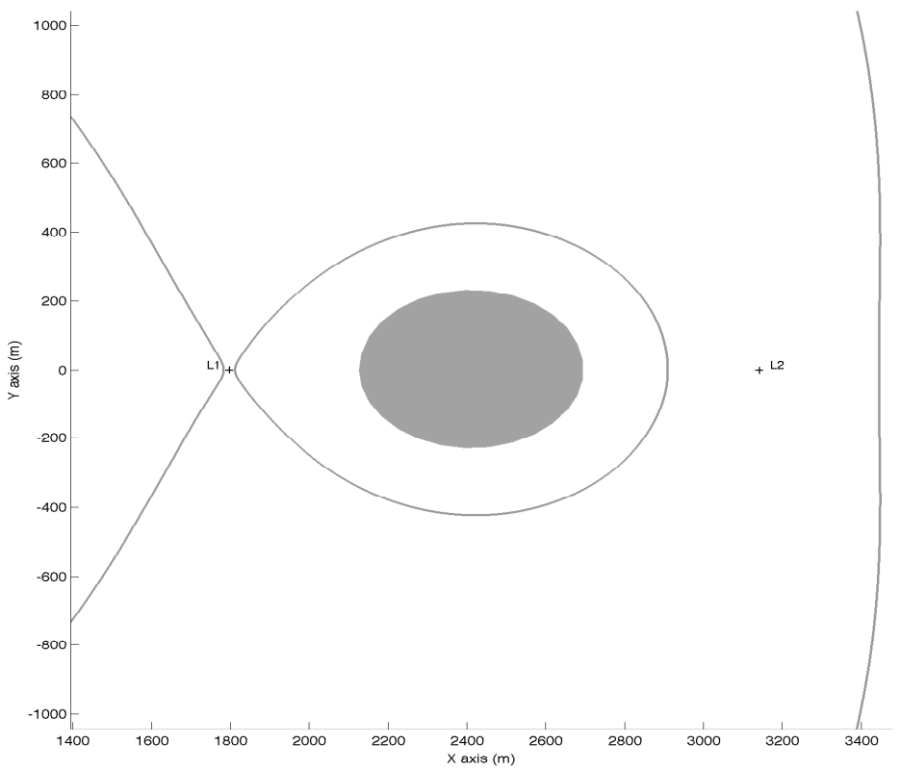
Grounding the lander
Grounding Lander
We reach the surface… but do we land ?
Neck closure criterion
➔7% speed damping at impact is sufficient

Slide 16
Main features of the landing strategy
Landing on the secondary is feasible for the vast majority of binary NEOs.
The deployment consists in releasing the lander in the L2 neck with a designated velocity direction and speed.
No GNC needed for the lander.
No risk for the mothership.
Margins that applies on deployment conditions are (for KW4) :
-100m to +100m on the nominal y-axis release position
0% to 500% error the nominal deployment speed
-90° to +90° on the nominal velocity direction

Slide 17
Questions?
ALPHA 1.1 mile
Outline of the 0VS
Landing Only
L1
Beta
Landing Zone
Zone of Lander Deployment
Trajectories from L2
L2

