Slide 1
Status of the Mars Entry Atmospheric Data System (MEADS) Hardware and Flight Data Reconstruction Effort Presentation at IPPW-9 20 June, 2012 Toulouse, France
Michelle M. Munk
NASA-Langley Research Center

Slide 2
Acknowledgements
Team Members (and coauthors, in bold) contributing to the MEADS flight data reconstruction effort:
Mark Schoenenberger (Lead)
Chris Karlgaard (simulation)
Prasad Kutty (simulation)
John Van Norman (aerodynamics)
Jeremy Shidner (trajectory)
Noah Favareh (aero testing)
Robert Blanchard
Rafael Lugo (Aberdeen testing, Monte Carlo methods)
Robert Tolson
Sean Commo
Scott Striepe
Chris Kuhl (MEDLI Chief Engineer)
Alan Little (MEDLI PM)

Slide 3
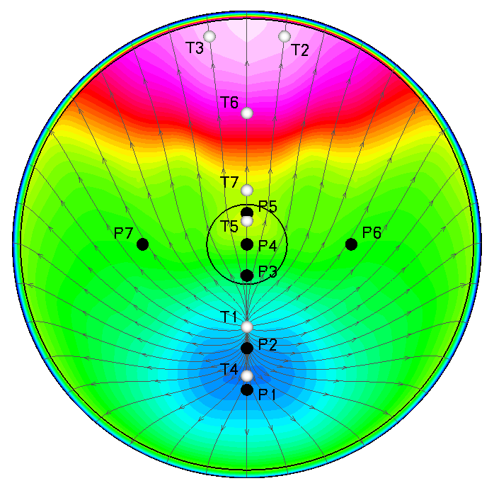
MEDLI System Objectives
Aerodynamics & Atmospheric
Confirm aero at high angles of attack
Separate aerodynamics from atmosphere
Determine density profile over large horizontal distance
Determine wind component
Aerothermal & TPS
Verify transition to turbulence
Determine turbulent heating levels
Determine recession rates and subsurface material response of an ablative heatshield at Mars conditions

Slide 4
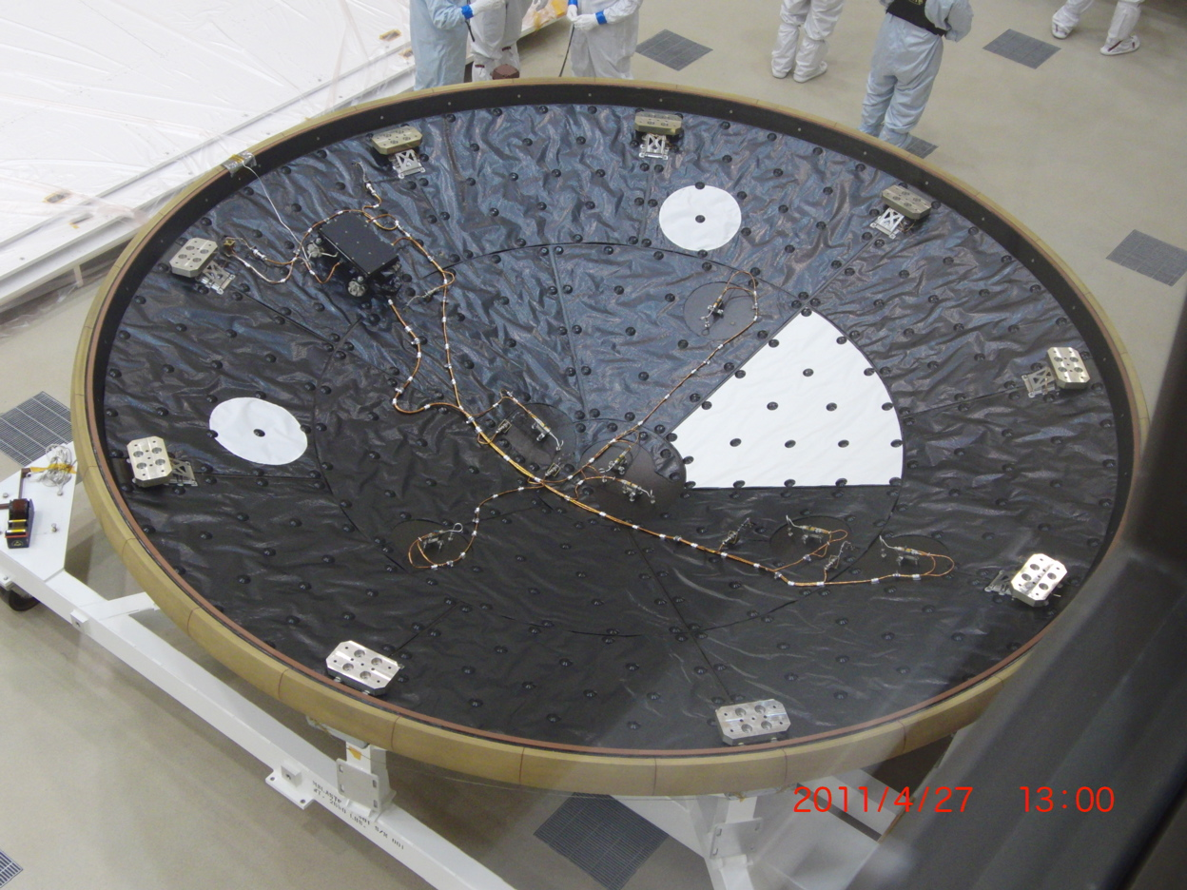
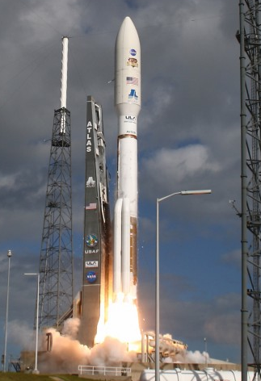
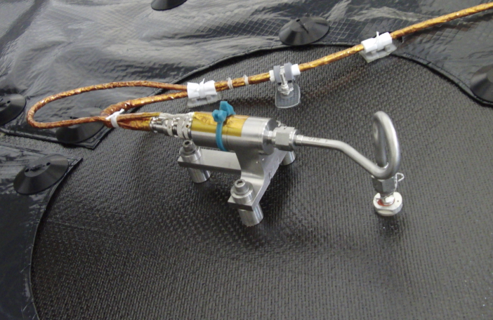
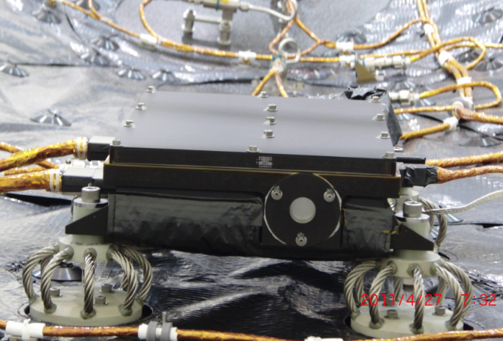
On Our Way to Mars!
Mars Science Laboratory
Heatshield
MEADS Port
SSE Box
STI Transducer
Launch – 26 Nov 2011

Slide 5
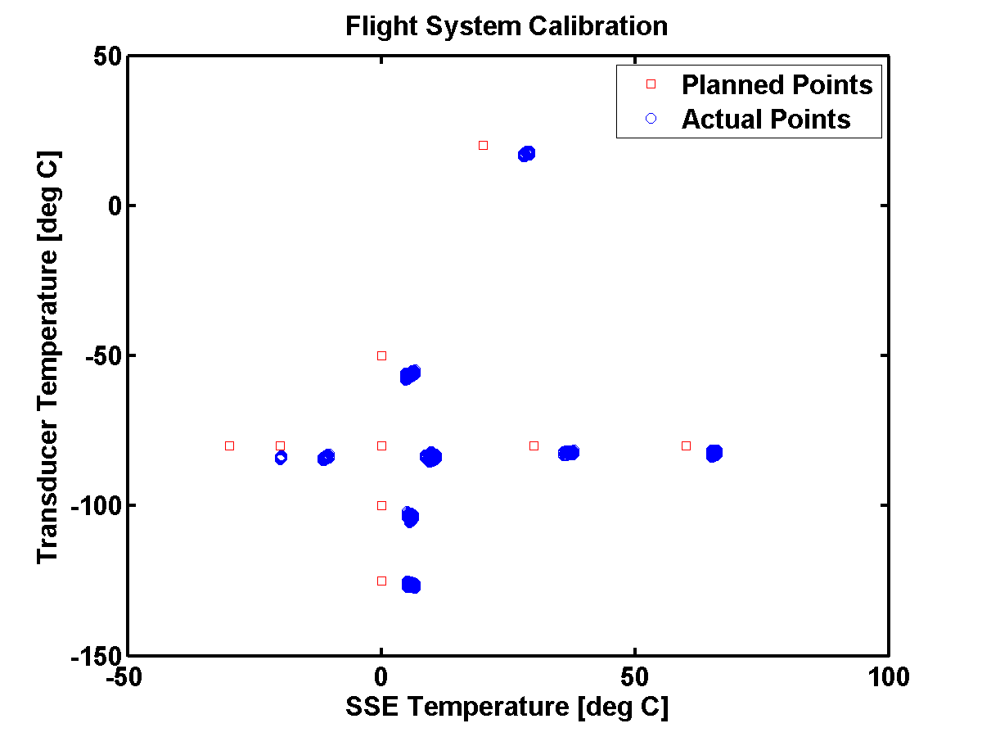
MEADS Pressure Data (In-Flight Zero)
MEDLI Cruise Checkout in March
All sensors functioning
Average MEADS Transducer Temperature = -65°C
Thermally stable SSE Temperature = +35°C
Cruise Checkout
MEAD S/N | Calibration Model (from thermal vac) (mV) | In-Flight Zero (mV) | Difference
022 | -0.37 | -0.27 | 0.1
025 | -0.48 | -0.39 | 0.09
029 | -0.75 | -0.70 | 0.05
021 | -0.52 | -0.39 | 0.13
032 | -0.15 | -0.08 | 0.07
023 | -0.70 | -0.70 | 0.0
024 | -0.90 | -0.81 | 0.09
Note: In-flight zero data will be used to update the calibration model prior to entry

Slide 6
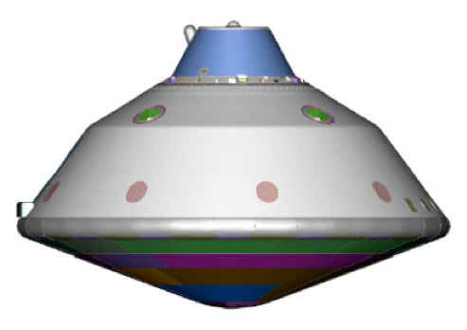
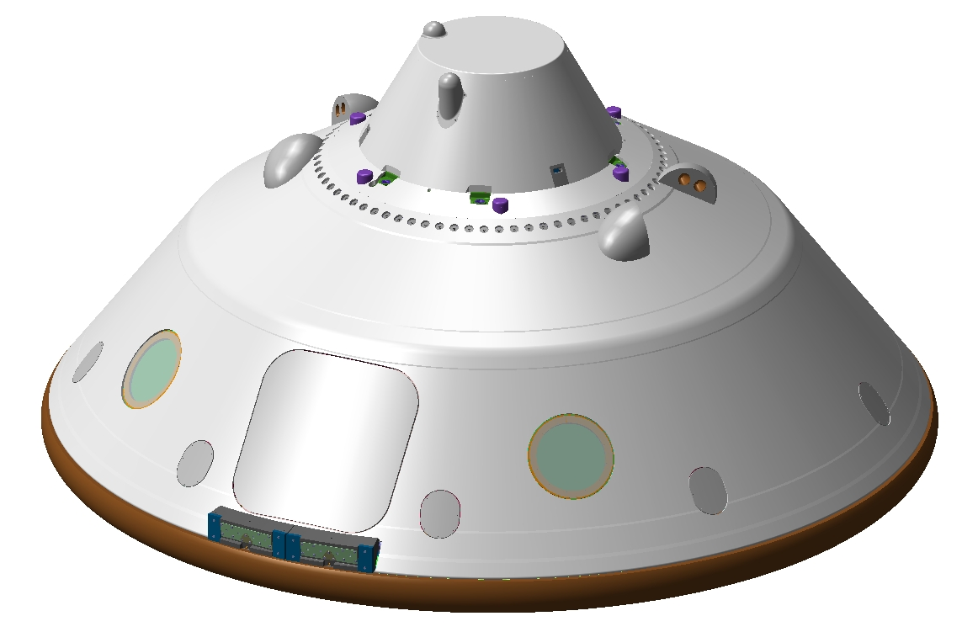
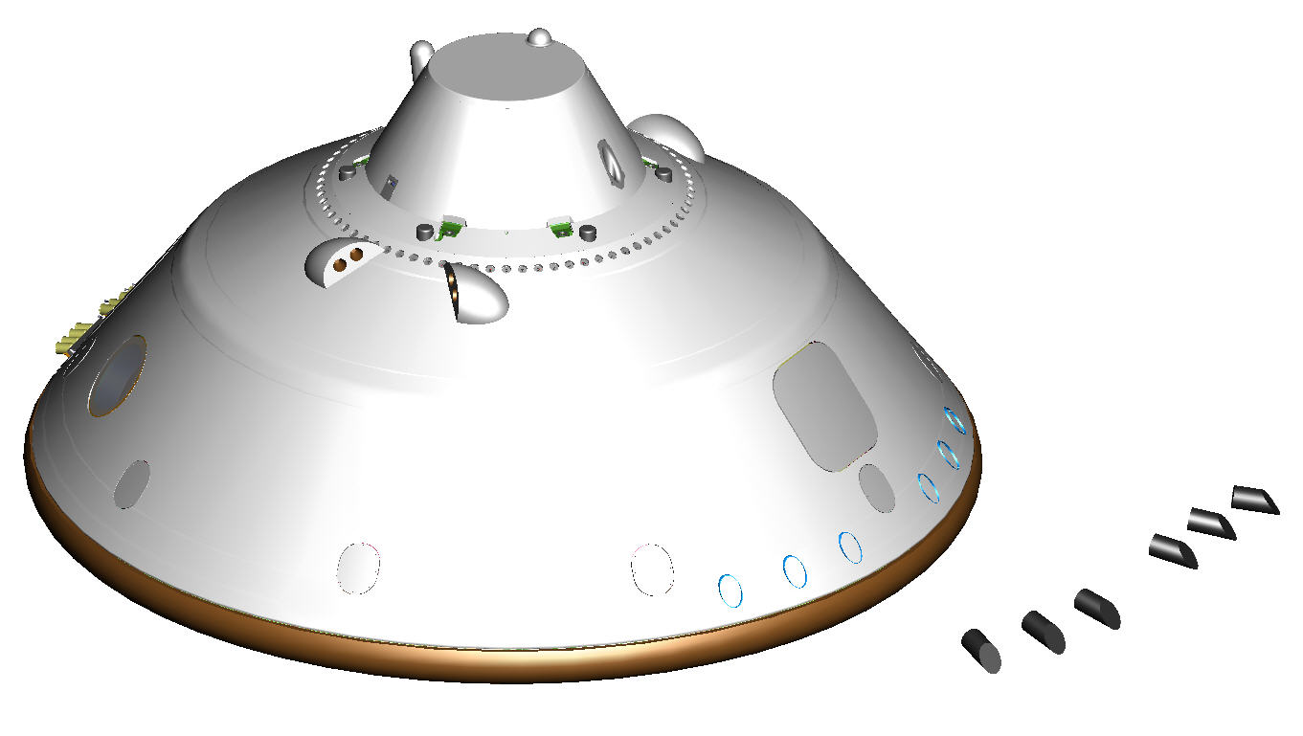
MSL EDL Timeline
MEDLI
data on
E – 10 min
Mach
28
Entry
Mach
3.3
Mach
2.1
INTERFACE
Peak Heating
Peak Decel.
SUFR
EBMD Jettison
h: ~125 km
V: ~5.8 km/s
Deploy Parachute
h: ~26 km
V: ~4.6 km/s
h: ~19 km
V: ~3.7 km/s
MSL Entry Vehicle
4.5 m diameter
70 deg sphere-cone
Entry Mass: 3200 kg
Hypersonic L/D: 0.24
Trim AoA: 17 – 20 deg
h: ~12 km
V: ~0.53 km/s
MEDLI
data off
h: ~10 km
V: ~0.47 km/s
q > 850 Pa
E-0 s
E+81 s
E+91 s
E+226 s
E+240 s

Slide 7
MEADS Science Objectives
Level 2 Requirement | Objective | Accuracy
PS-371 | Reconstruct basic surface pressure | None specified
PS-372 | Reconstruct Angle of Attack | ± 0.5˚ when P > 1750 Pa
PS-373 | Reconstruct Angle of Sideslip | ± 0.5˚ when P > 1250 Pa
PS-374 | Reconstruct dynamic pressure | ± 2% when P > 850 Pa

Slide 8
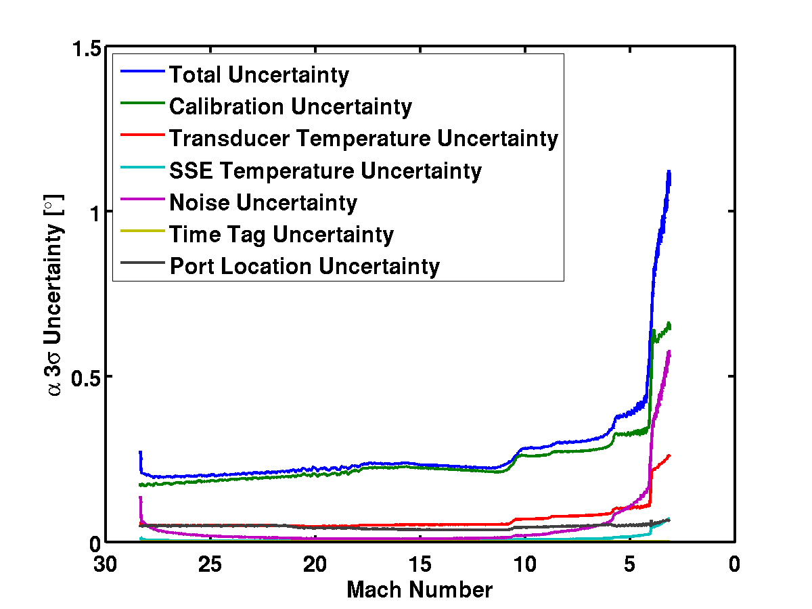
MEADS: Angle of Attack Uncertainty*
Curves end at
850 Pa limits
Requirement not met at low supersonic conditions
Low q: Low signal-to-noise
MEADS angle-of-attack requirement
*Perfect CFD assumed

Slide 9
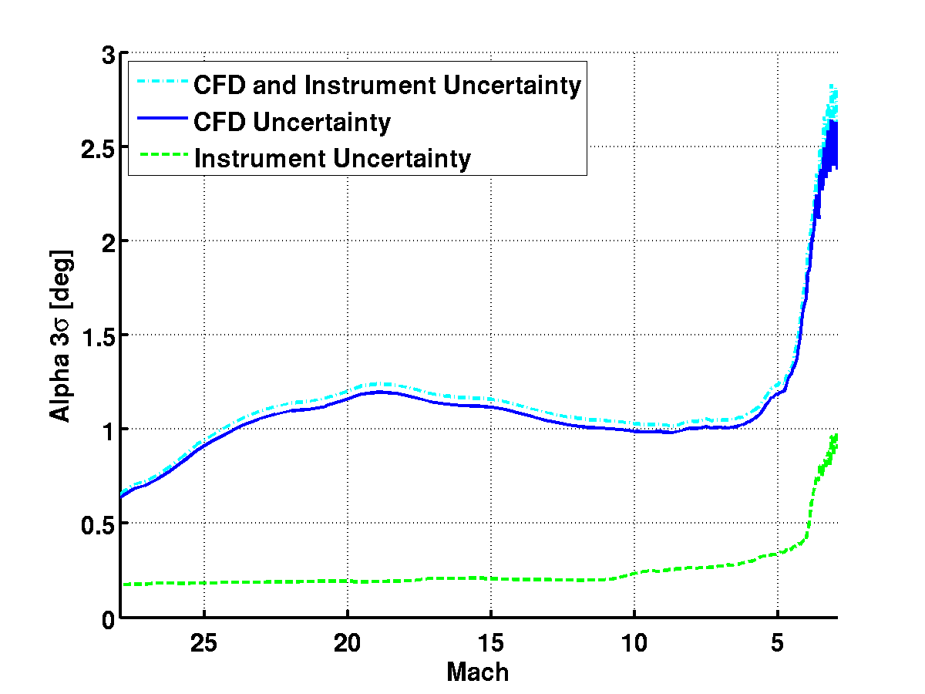
MEADS: Angle of Attack Uncertainty
MEADS alpha requirement
Curves end at
850 Pa limits

Slide 10
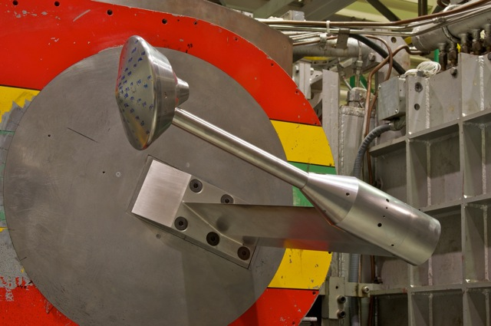
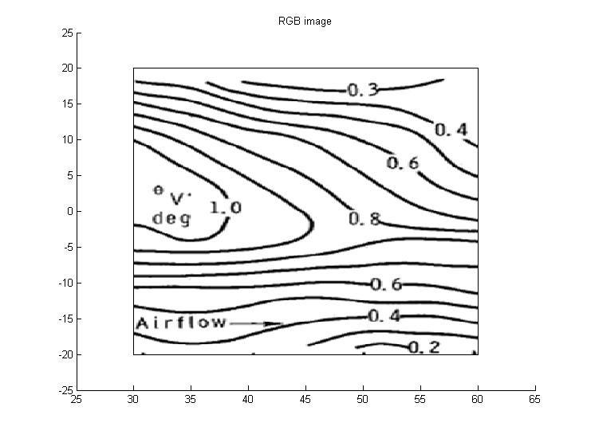
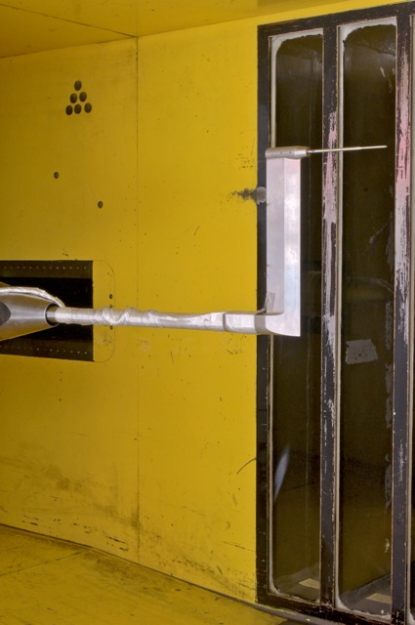
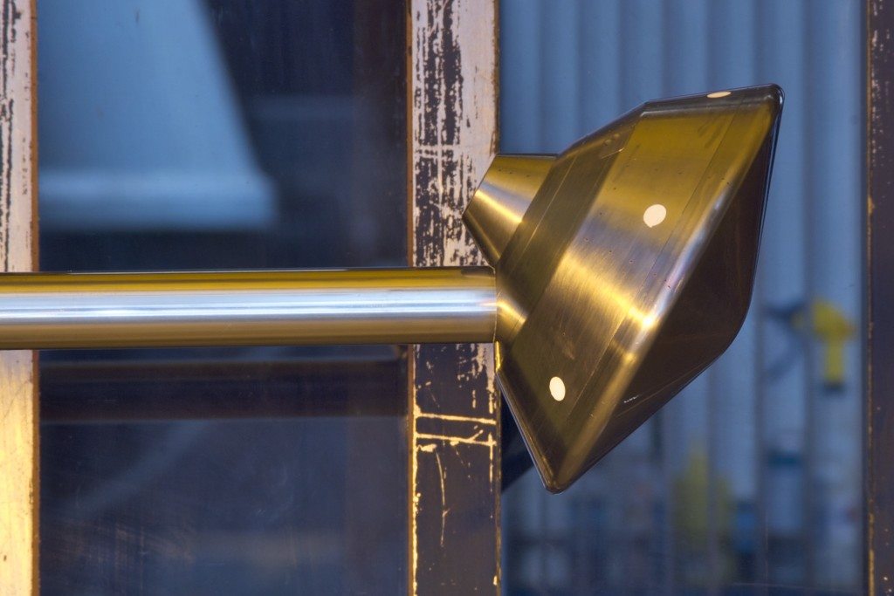
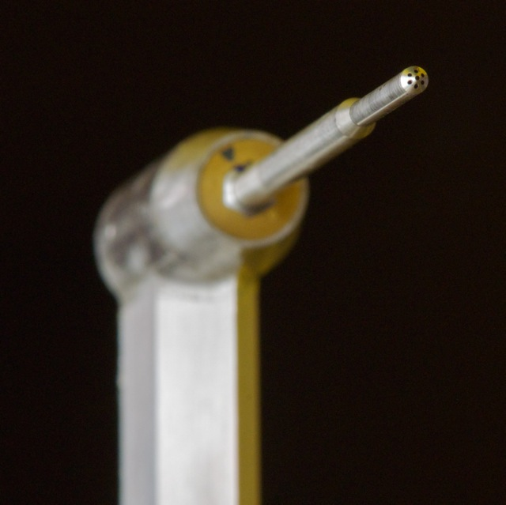
CFD Uncertainty and Calibration
CFD V&V Test Facilities:
LaRC UPWT
Mach 2.5, 3.5, 4.5 Pressure model
Flow Angularity survey
LaRC 31” Mach 10
Pressure model
Mach 10 Pressure Test
November, 2011
UPWT Flow Angularity
November, 2011

Slide 11
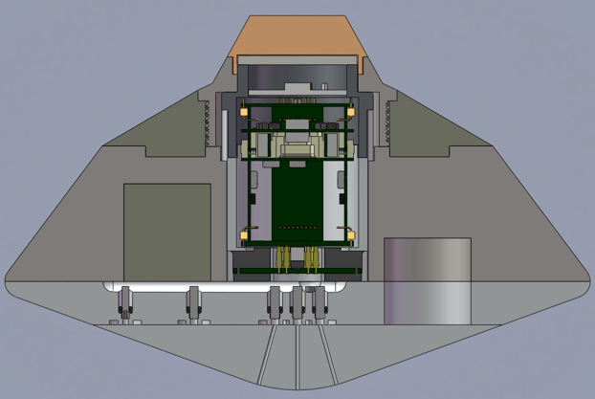
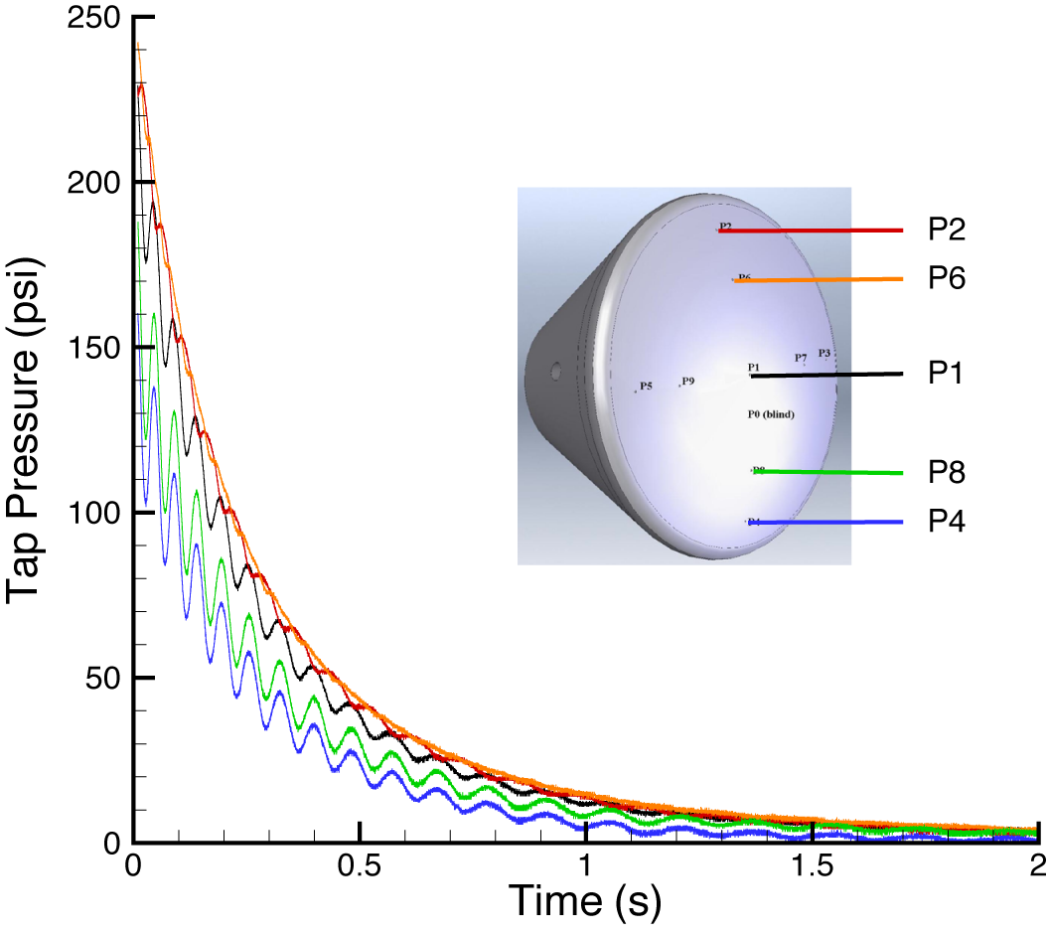
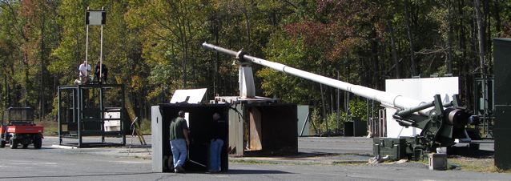
Aberdeen Proving Grounds Ballistic Range Test
6.75” diameter
16.2 lb
IMU telemetry package
A series of ballistic range tests were conducted to demonstrate and refine the reconstruction approaches.
Each model telemetered onboard pressure, accelerometer, rate and magnetometer data, and tracked by radar.
Testing in air makes wind tunnel data directly relevant (no CO₂ vs Air uncertainty)
RADAR tracking provides inertial trajectory path “truth” to within meters.
MET data provides Mach measurements with accuracy of RADAR velocity measurements.
Kulite transducers read MEADS pressures
Example CEV pressure data (Aug 2009)
Aberdeen Proving Grounds 7” Gun
Initial Mach: ~3.6
~10 kHz data rate
~10 s flight data

Slide 12
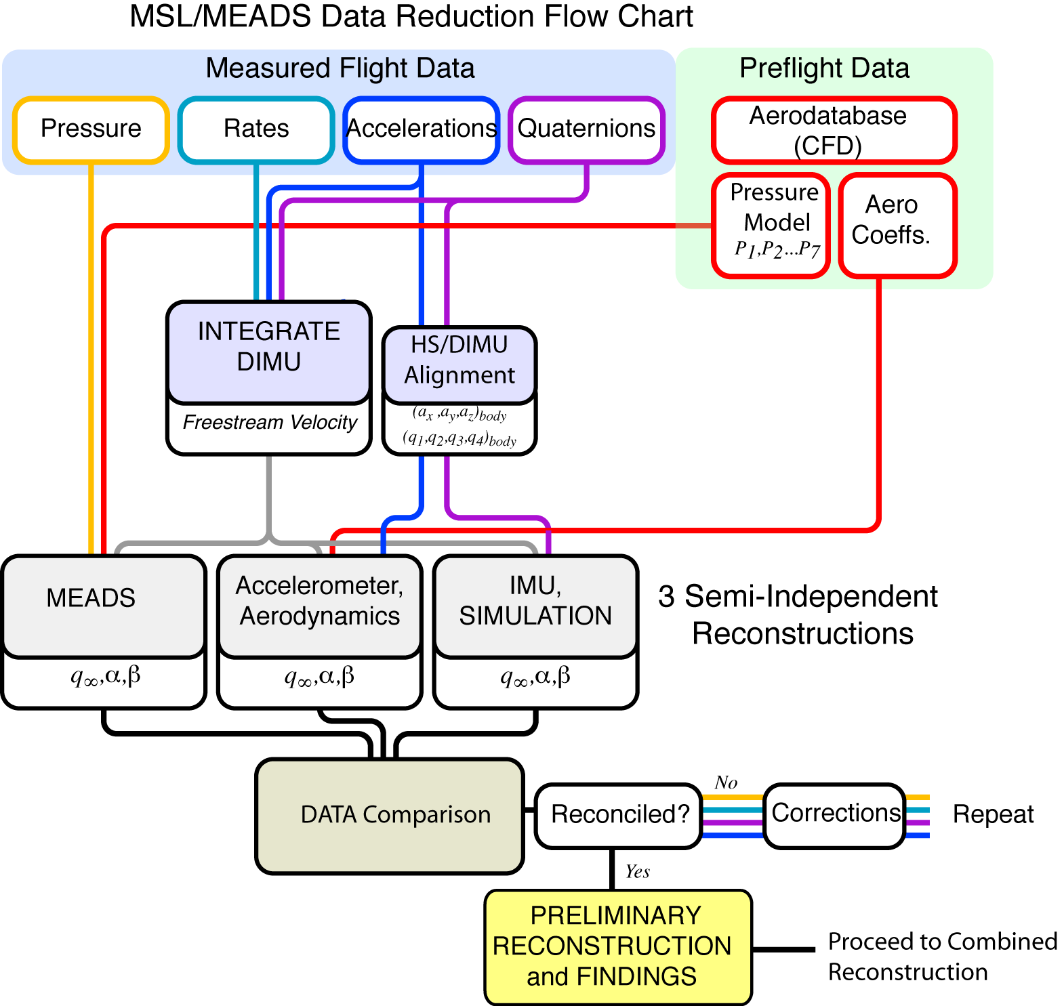
Reconstruction Tool Testing
Comparing 3 independent reconstructions with uncertainties identifies suspect data
In addition to MEADS,
uncertainty analysis of all data sources is being done concurrently
Using MSL design trajectories with simulated telemetry, run all 3 methods and compare results
We are HERE,
working with simulated
data from MSL team

Slide 13
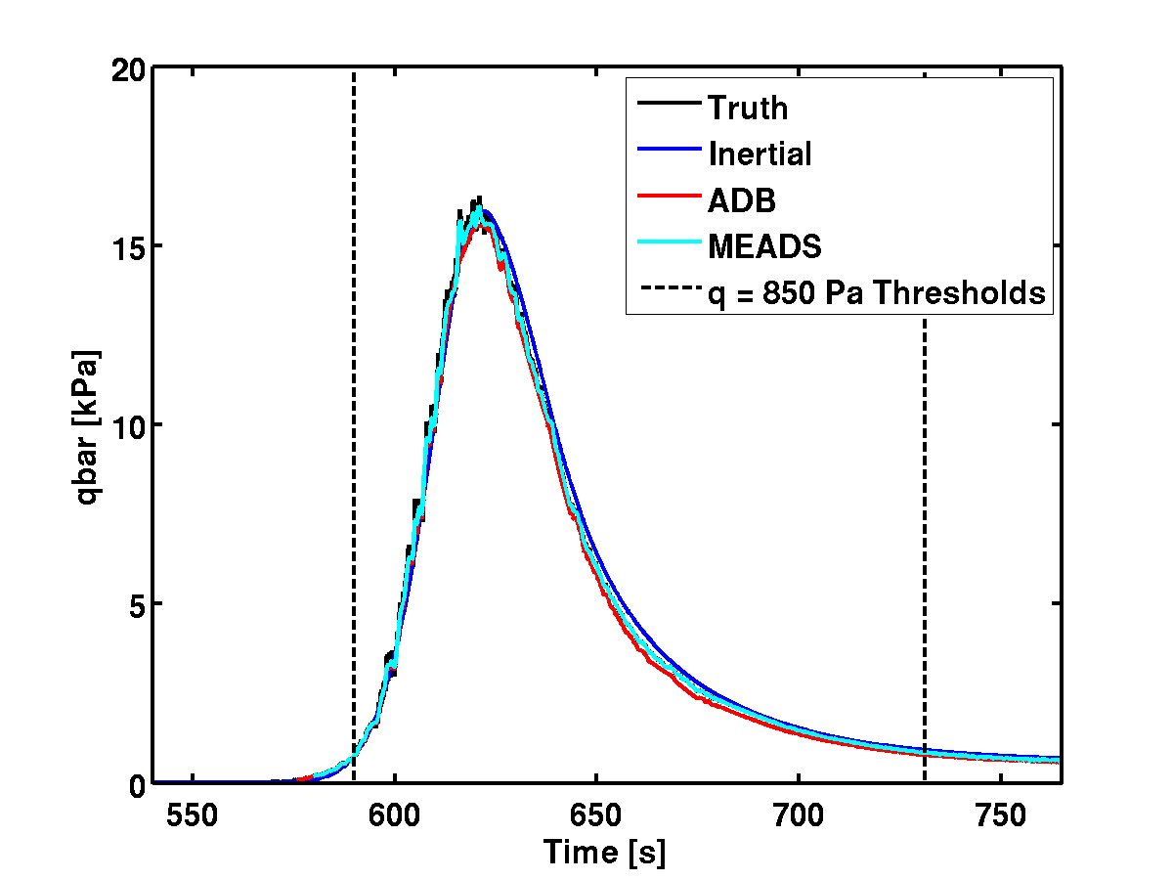
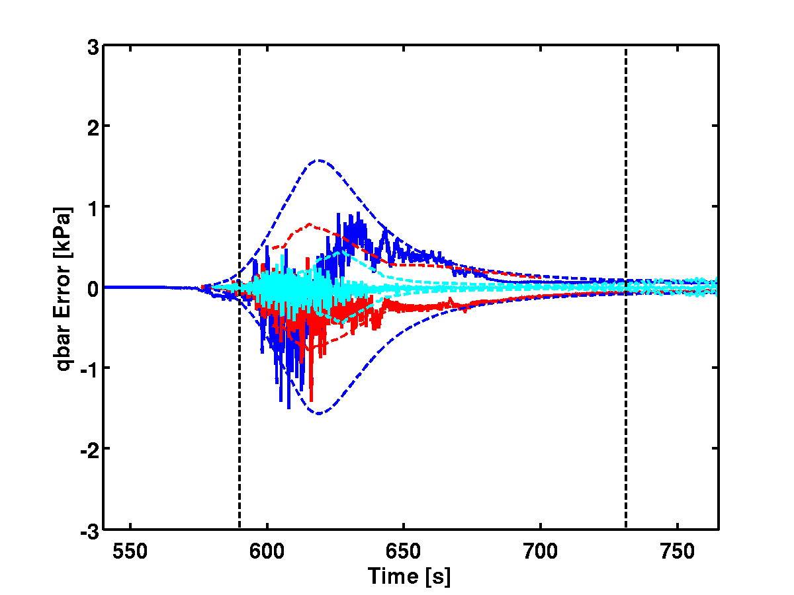
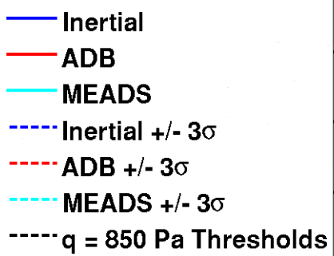
Reconstruction Tool Test: Dynamic Pressure (3σ low C_{A} case)
Inertial reconstruction slightly high
ADB reconstruction slightly low
MEADS pressure readings tell us that everything is fine; it’s an aero database problem
MEADS data improves observability of the issues

Slide 14
Additional Reconstruction Work
POST-based reconstruction (Striepe and MSL trajectory team)
Extended Kalman filter in POST2 architecture
Utilizes MSL flight simulation (best state estimates available for EKF)
This effort will become an updated version of the MSL trajectory team’s reconstruction work done for past Mars Missions.
Reconstruction NRA awarded to NIA university team (Robert Blanchard, PI)
Adds statistical uncertainty analysis to existing reconstruction methods
This effort will add continuity to the independent reconstructions funded by recent Mars missions. New capabilities (and new data) should improve (and better quantify) accuracy.
MISP Reconstruction relies somewhat upon reconstruction of MEADS data
The combined comparison of all of these reconstructions (each with the benefit of the MEADS data) will provide the best assessment of the MSL trajectory, help understand data from past missions, and yield the most information to assist future missions.

Slide 15
Current Status of MEDLI Project
2 Cruise checkouts have occurred (March, April 2012)
Full dataset returned for practice with formatting, check against qualification testing ranges, etc.
Working with JPL and EDL simulation team to determine data flow, products, and timing (first team meeting was 12/14/11)
All primary MEADS reconstruction codes for processing flight data have been written and checked out
Held Peer Review of methods in January 2012
Reconstruction Readiness Review in late July at ARC
Entry: August 6, 2012 ~1 a.m. EDT
MEDLI Operations Engineer, Chief Engineer, MEADS Reconstruction Lead will be at JPL for entry
“Real-time” data: 16 selected measurements at 1 Hz
MEDLI also generates tones during EDL: 5 catastrophic, 3 progressive
Anticipate full dataset 1-2 weeks after landing

Slide 16
MSL/MEDLI Reconstruction Process
L + 1-2
days
L + 1-2
weeks
∼ 3
months
∼ 4
months
1
year
Level ≤ 3
Configuration-controlled,
Filtered Data Drop
L + 2 wks
Heat Shield Rot., Defl., Translation
Other Sources
(Radiometric)
MEADS Data
Adjudication
Level 4
Level 4+
Flight
Data
Level 0
PET¹
PBET^{2,3}
BET
Doc
Rev A
Doc
Rev B
+ JSR Special Issue
Resolve Discrepancies&
Write Papers
¹RTDP
integrated from
top down.
²Needs full data set
plus HiRISE
Image.
³JPL GN&C subsystem is on contract to do this.
MCS
Kalman Filter
Mesoscale Model
MISP Initial Product MISP-II MISP-III
∼ 2 times/week meetings
Issues/
Discrepancies
List

Slide 17
Thank you!

Slide 18
Backup

Slide 19
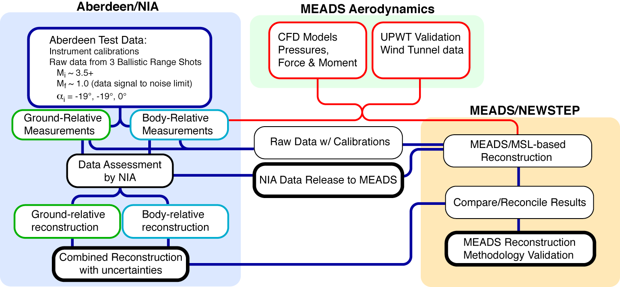
Motivation and Benefits of Aeroballistic Testing
Flight data from aeroballistic testing can be used to test various reconstruction techniques (data sources include IMU, pressure taps, and radar)
Radar tracking data permits comparison to “truth” trajectory solution (inertial position and velocity)
Other available data: magnetic field vector from magnetometers and MET data
Deliverables

Slide 20
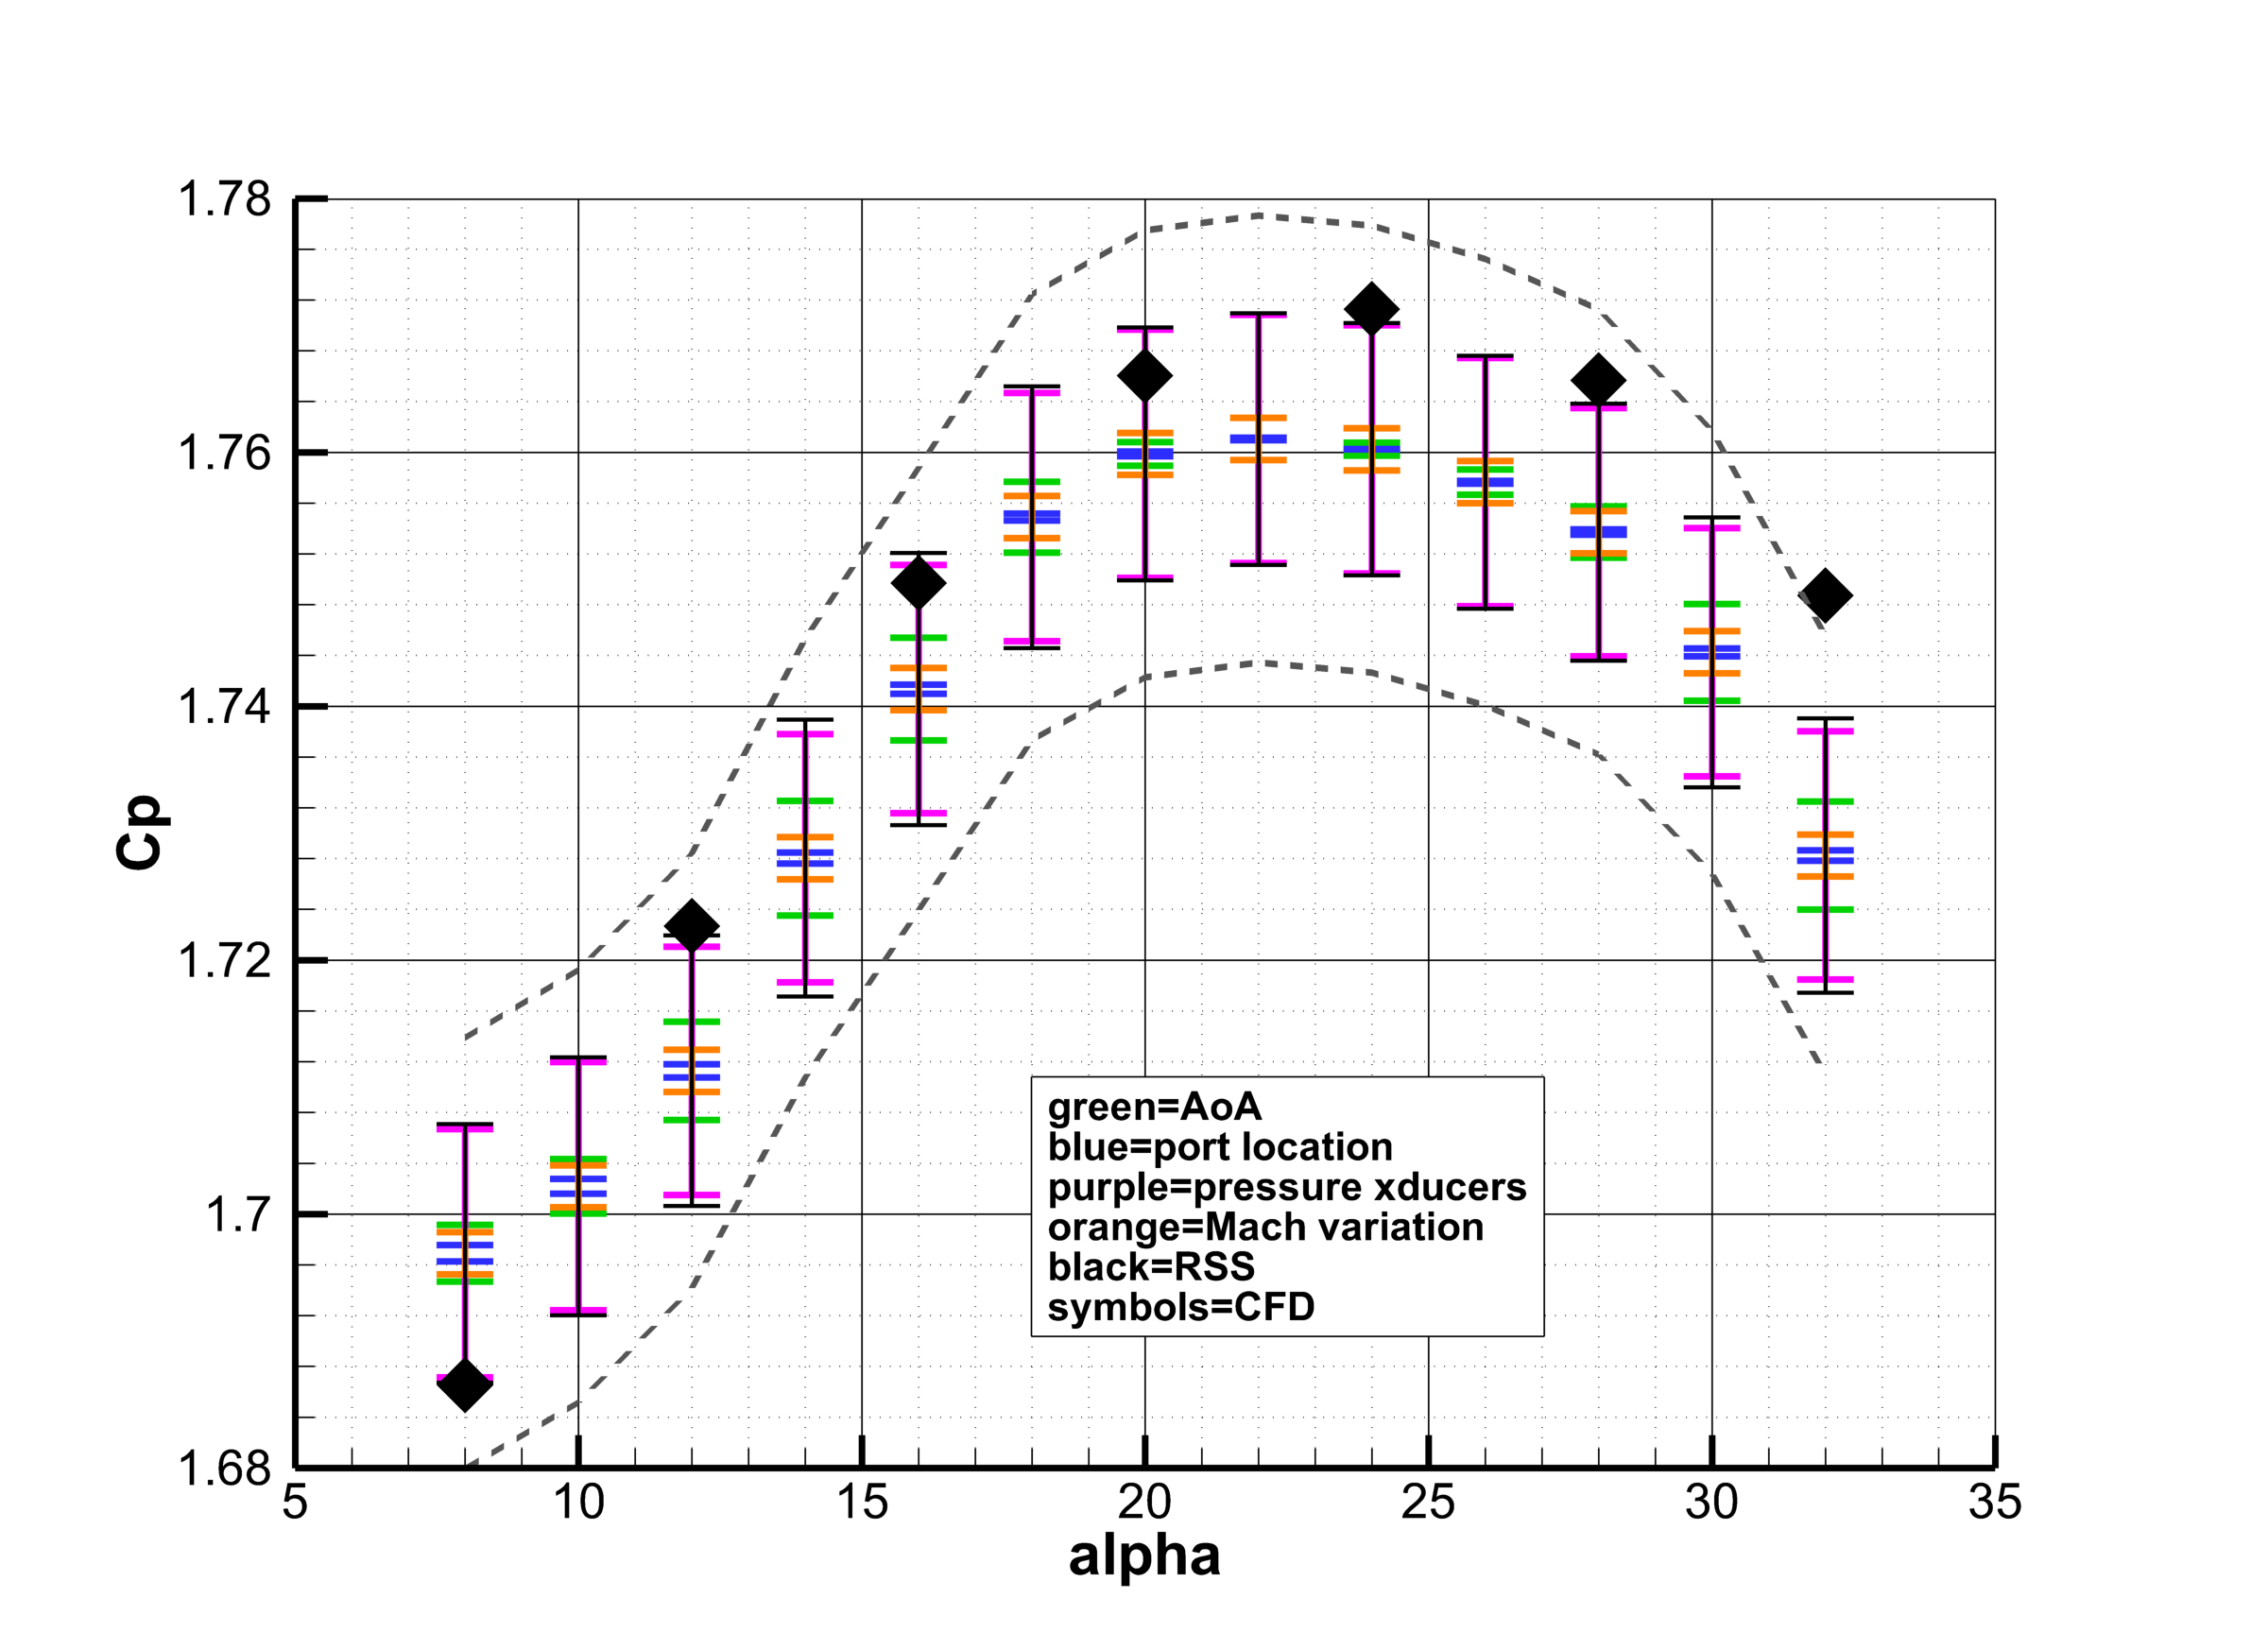
1σ Uncertainty Stackup Example: P1
Dashed lines show ± 1% bound on averaged experimental data.
20

