Slide 1
Parachute Development for Venus Missions
Christopher Kelley – Airborne Systems
Robert Sinclair – Airborne Systems
Dr. Anita Sengupta – Jet Propulsion Laboratory
IPPW-9 ~ Toulouse, France

Slide 2
Introduction
Overview of parachute sizes and mass for given entry mass
Design drivers
Design cases
Materials
Planform
Testing

Slide 3
Design Drivers
Highly Corrosive Atmosphere
Sulfuric Acid
Drives material selection
Similar Atmospheric Density at Deployment Altitude to Earth
At 50 km, 1 Bar, 75ºC
Simplifies testing
Rate of Descent
Typically at a proscribed altitude, not at landing due to thick atmosphere
Deployment
Mortar deployed parachute to push parachute through base region of reverse flow behind vehicle

Slide 4
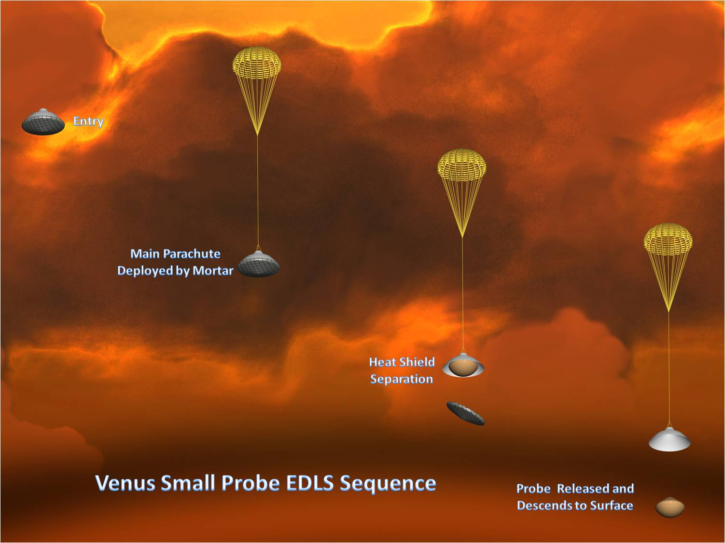
Small Probe Sequence
100 kg entry mass
Mortar deployment of main parachute
Heat shield separation after stabilization
Release probe at required point
1.8 m parachute
2.5 kg total mass, mortar and parachute

Slide 5
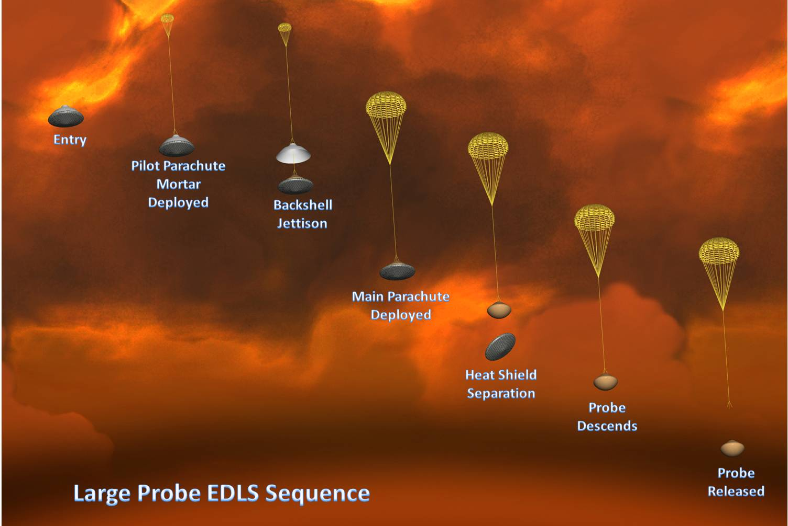
Large Probe Sequence
500 kg entry mass
Mortar deployment of pilot parachute
Backshell released immediately following pilot mortar fire
Pilot separates backshell, extracts main parachute
Heat shield separation after stabilization
Release probe at required point
5.0 m parachute, 7 kg total system mass

Slide 6
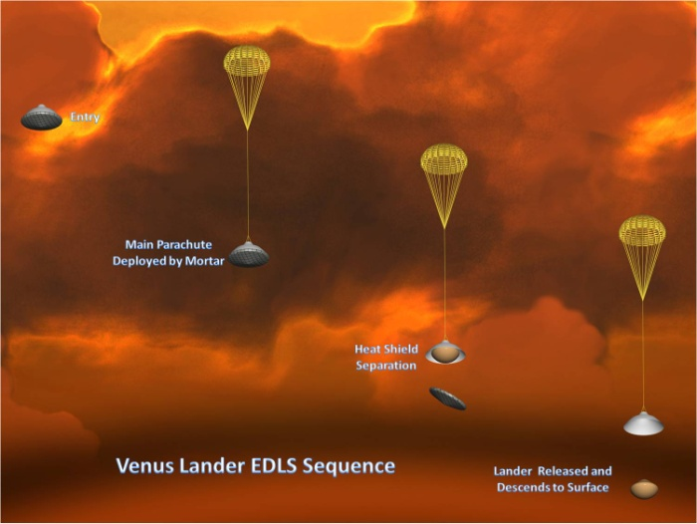
Lander Sequence
1,000 kg entry mass
Mortar deployment of main parachute
Heat shield separation after stabilization
Release lander at required point
5.0 m parachute
11 kg total mass, mortar and parachute
Higher mass due primarily to larger mortar

Slide 7
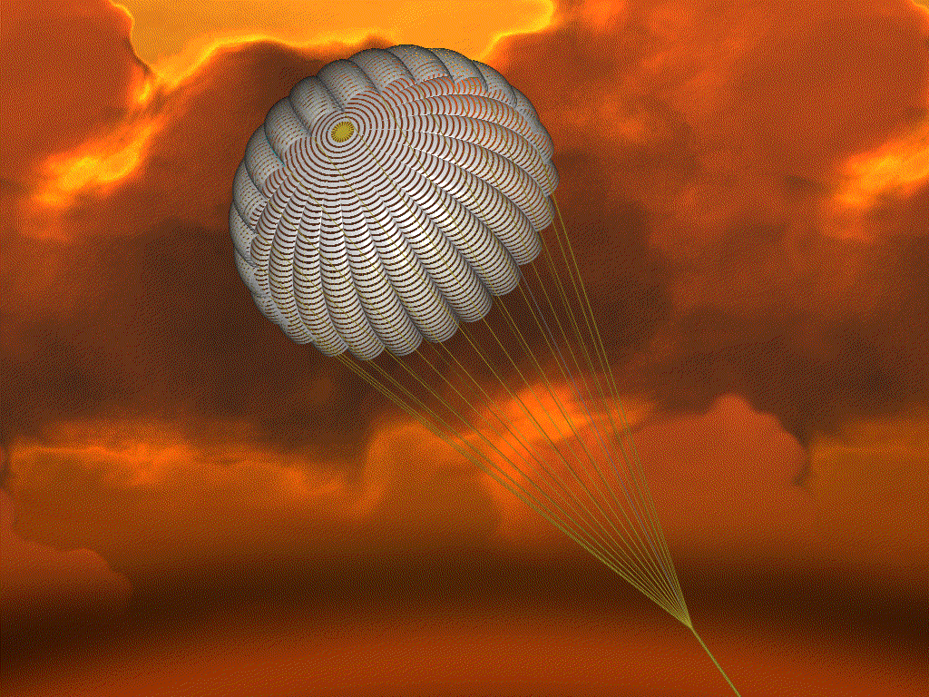
Other Options
Higher deployment Q
Typical Venus mission deploy M=0.80
Conical ribbons deploy reliably up to M=2.0
Larger parachute
Conical ribbons over 12 m have been flown
Allows ~2,000 kg entry mass

Slide 8
Materials
Sulfuric acid clouds at parachute deployment altitudes
50 to 62 km
80% concentration at 80ºC
Pioneer Venus used Dacron®
Current choice fabric is Vectran®
High tenacity liquid crystal polymer
Very resistant to sulfuric acid
Has space heritage
Airbags for Pathfinder, Mars Exploration Rovers
Meets total mass loss and collected volatile condensable mass requirements

Slide 9
Planform
Pioneer Venus used ribless guide surface drogue and conical ribbon main
Intended architecture was RGS for both
1.37 m RGS pilot performed well in testing
6.74 m RGS main demonstrated inflation and equilibrium problems
Substituted 4.5 m conical ribbon
Use heritage RGS pilot for small probe, or large probe pilot
Use heritage conical ribbon main for lander or large probe main
Investigate other options such as variable porosity conical ribbon if need to qualify a new parachute

Slide 10
Full Scale Testing
Qualify components individually, then complete system end-to-end flight test
Recent and current Mars missions all use Viking data from tests in early 1970’s
Leverage data from Pioneer Venus and extensive parachute testing conducted in 1960’s and 1970’s
Two options for end to end testing
High altitude balloon drop
Sacrifices angle of attack and flight path angle for less expensive testing
Intermediate altitude balloon drop with rocket boost
Achieves specific angle of attach and FPA

Slide 11
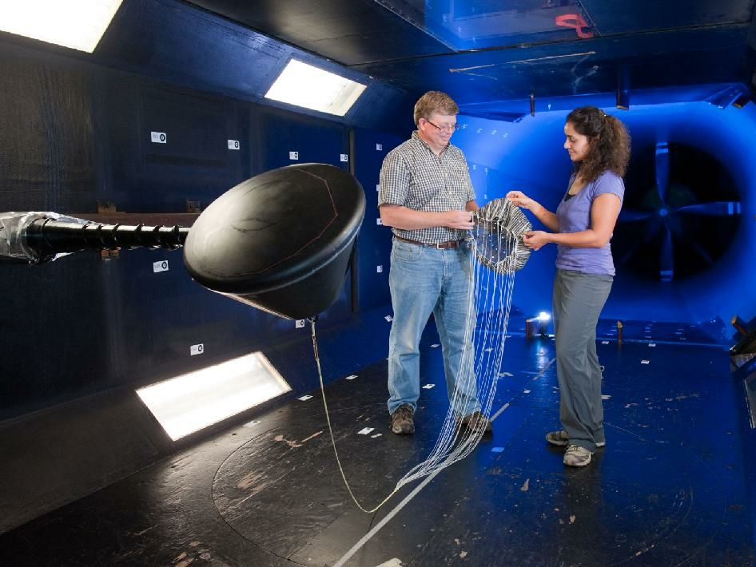
Scaled Testing
Until recently, scaled testing of ribbon parachutes not practical
NASA has successfully tested a 10% scale model of Orion capsule drogue parachute (VPCR)
Results compare favourably with drop test data from Orion test campaign
Note that scaled testing can augment full size testing, not replace it.
10% Scale Conical Ribbon in Texas A&M Low Speed Tunnel
(Photo courtesy of NASA)

Slide 12
Questions?

