Slide 1
Technology Development toward Mars Aeroflyby
Sample Collection
9th International Planetary Probe Workshop
Toulouse, France
June 2012
K. Fujita*,
T. Ozawa*, K. Okudaira†, T. Mikouchi‡, T. Suzuki*, H. Takayanagi*, Y. Tsuda*, N. Ogawa*, S. Tachibana‡, and T. Satoh*
* Japan Aerospace Exploration Agency
† University of Aizu
‡ University of Tokyo

Slide 2
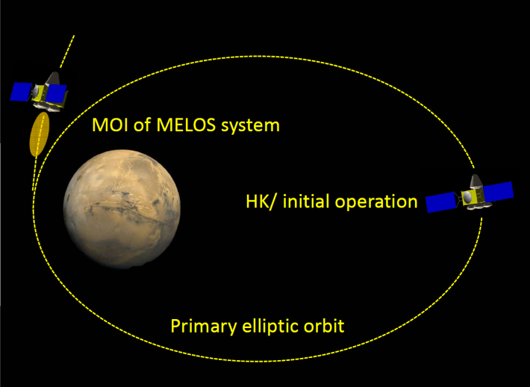
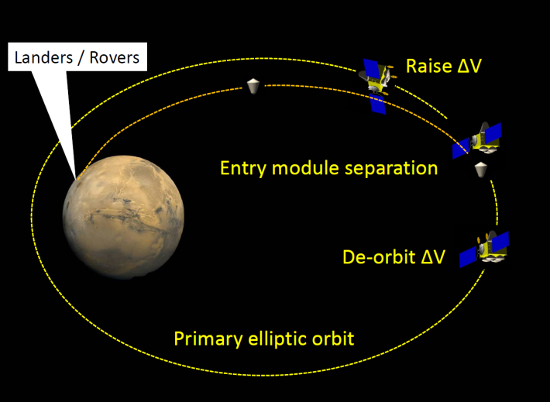
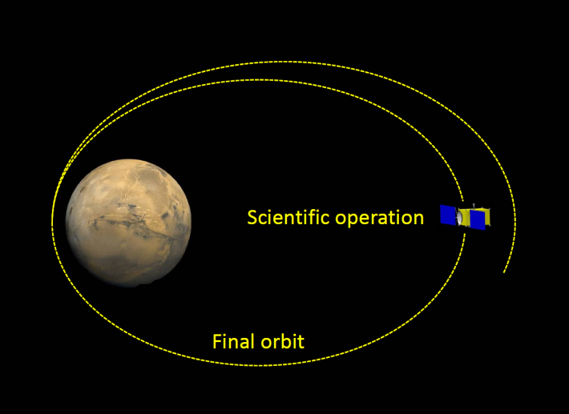
Background
Mars Exploration with Landers & Orbiters Synergy (MELOS)
  Currently entertained in Japan (2020 launch)
  Conglomerate mission where orbiters, landers, rovers, and/or airplanes are used for aeronomical, meteorological, and geoscientific researches as well as life search
  To reveal why Mars is now in red – the fate of ancient water and carbon dioxide on the course of Martian history
Mission scenario
  MELOS system is first inserted into primary orbit altogether
  Entry systems are flown into Martian atmosphere using orbiter as a service module
  Orbiter is maneuvered to final orbit for scientific operation
  → Great potential for a variety of probe vehicles incorporated into MELOS
Notes:
Mars Exploration with Landers and Orbiters Synergy (MELOS) is currently entertained in Japan Aerospace Exploration Agency (JAXA) in collaboration with a large number of planetary science groups over Japan.
As its name suggests, the MELOS mission is designed as a conglomerate mission, in which orbiters, landers, rovers, and/or airplanes are used for aeronomical, meteorological, and geoscientific researches as well as life search to reveal why Mars is now in red, that is, the fate of ancient water and carbon dioxide on the course of Martian history.
In the mission scenario, the landers and the orbiters are transported to Mars and initially inserted into an extended elliptic orbit altogether, then the landers are transferred into the atmospheric entry orbit by using the orbiter as the entry service module, after which the orbiters are maneuvered to their respective final orbit. Such a mission scenario has great potential for a variety of probe vehicles incorporated into the MELOS mission. In this article, as one of the candidate subsystems for the MELOS mission, a Mars Aeroflyby Sample Collection (MASC) system using the aeroassist orbit transfer (AOT) technologies is proposed.

Slide 3
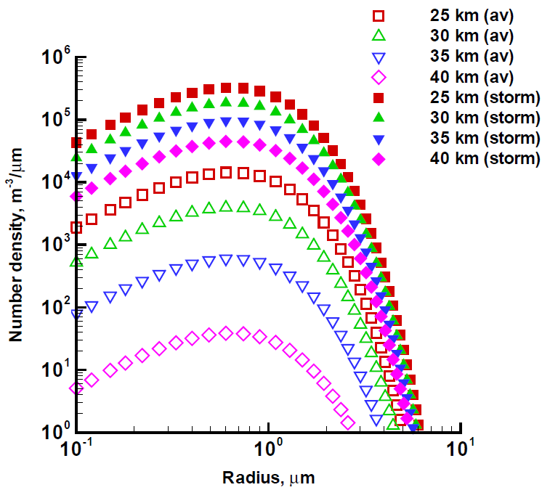
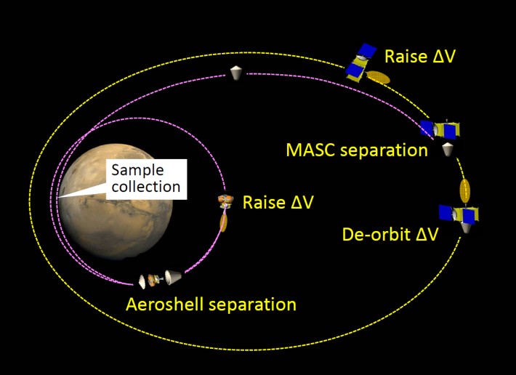
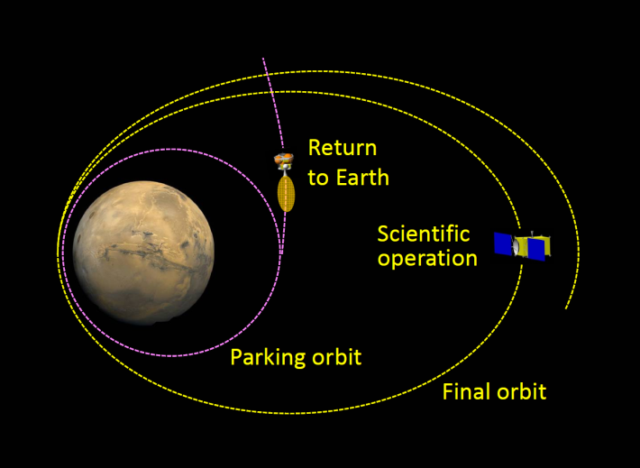
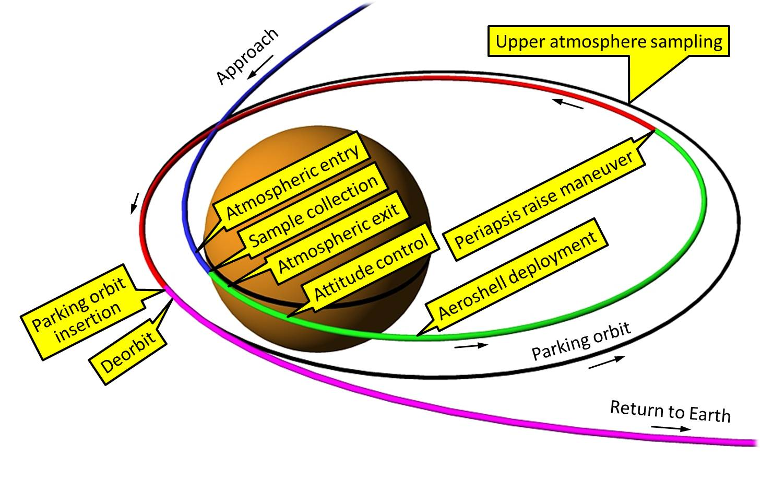
Mars Aeroflyby Sample Collection (MASC)
Mission concept
  Collection of Martian dust & gas samples during aeroflyby and return to Earth
  Originally proposed by Leshin et al. as a candidate for Mars Scout mission
Scenario
Advantages
  Valuable geological and aeronomical information on climatic vicissitude of Mars may be obtained at reasonable cost (compared to SR missions using a gigantic system)
  Current dust models can be verified → better understanding of Martian climate
  Sample return allows us more detailed analysis in Earth than in-situ analysis
  Sample return allows us future reexamination of samples with improved instruments
Altitude (km) | Dust fluence for V = 4 km/s (count/cm².sec)
 | Diam. = 0.5–1.5 μm | 1.5–2.5 μm | 2.5–3.5 μm | 1–10 μm
45 | 0.05 | 0.04 | 0.02 | 0.23
40 | 4 | 3 | 1.4 | 16
35 | 56 | 48 | 23 | 252
30 | 367 | 312 | 148 | 1650
25 | 1331 | 1129 | 536 | 5984
20 | 3526 | 2991 | 1420 | 15849
Notes:
Mars sample return missions commonly entertained may require a gigantic and complex system, consisting of an atmospheric entry vehicle, a lander to collect samples on the ground, a launcher to take them to a Martian orbit, and a return vehicle to transport them to the earth. Meanwhile, it is widely known that small particles of several micrometers in diameter, or dust particles, in which global and averaged geological information of the Martian surface is expected to inhere, are frequently blown up from the Martian surface and kept suspended in the atmosphere up to 40 km altitudes. If such dust particles as well as Martian atmospheric gases are collected during the aero-flyby and brought to the earth, valuable geological and aeronomical information on climatic vicissitude of Mars may be obtained at reasonable cost. Such a concept was first proposed by Leshin et al.¹⁰ as one of the candidates for the Mars Scout mission, namely the SCIM mission, based on sample return technologies of STARDUST and GENESIS.

Slide 4
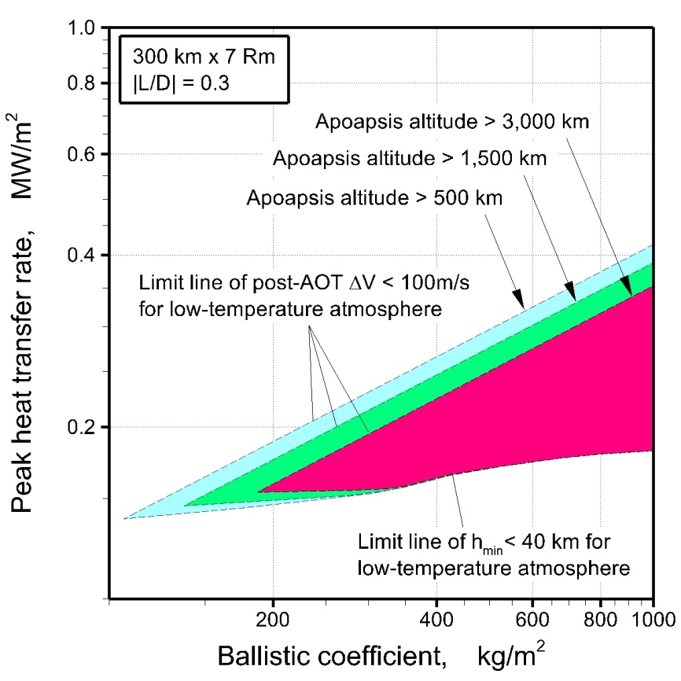
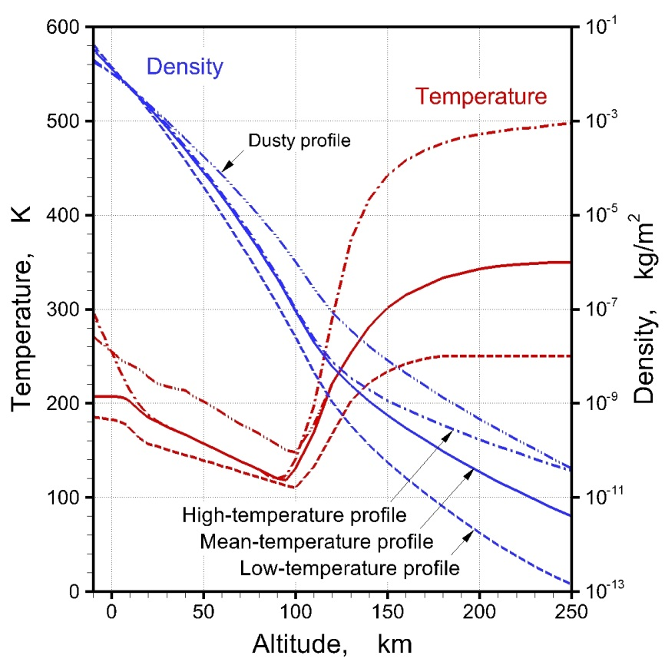
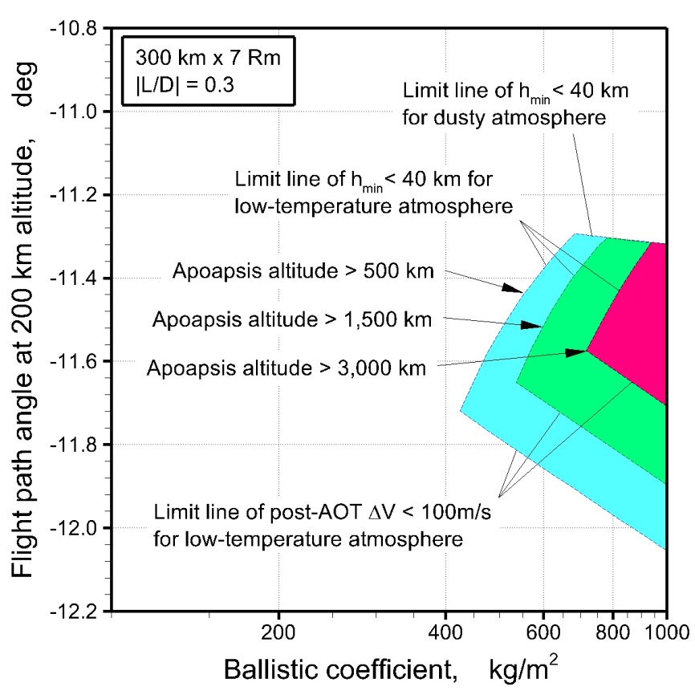
Fundamental Design Parameters for MASC
Critical keys
  Successful insertion to an orbit appropriate for earth return : precise GNC using lifting aeroshell is needed to cope with uncertainties in atmospheric density, aerodynamics of vehicle, & orbit/attitude determination
  Minimization of total ∆V required for AOT, post-AOT maneuver, and earth return
  Accessible lowest altitude < 40 km for sample collection
  Minimization of TPS for aerodynamic heating
Trajectory calculations
Initial orbit | 300 km×7Rm alt.
Periapsis altitude of target orbit | 150 km
Ballistic coefficients | 100 to 1000 kg/m²
Lift-to-drag ratio | – 0.3 to 0.3

Slide 5
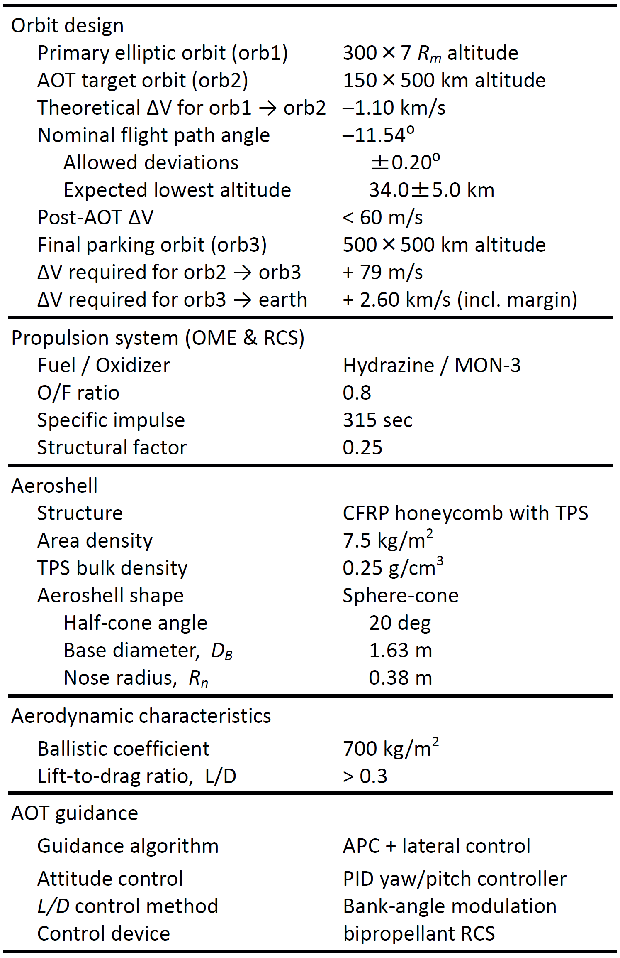
Fundamental Mission Design
Design criteria
  Minimize total system mass (minimum dry mass of earth return subsystem may be almost determined by heritages of past systems)
  Decrease propellant mass for earth return to minimize mass of orbiter subsystem
  Increase apoapsis altitude of parking orbit to decrease ∆V for earth return
  Decrease β for reduction of TPS mass
  Increase β to enlarge ATO corridor

Slide 6
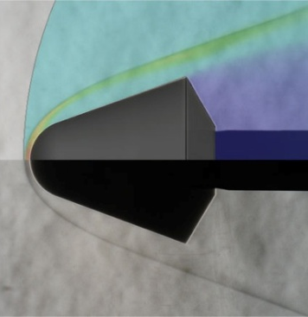
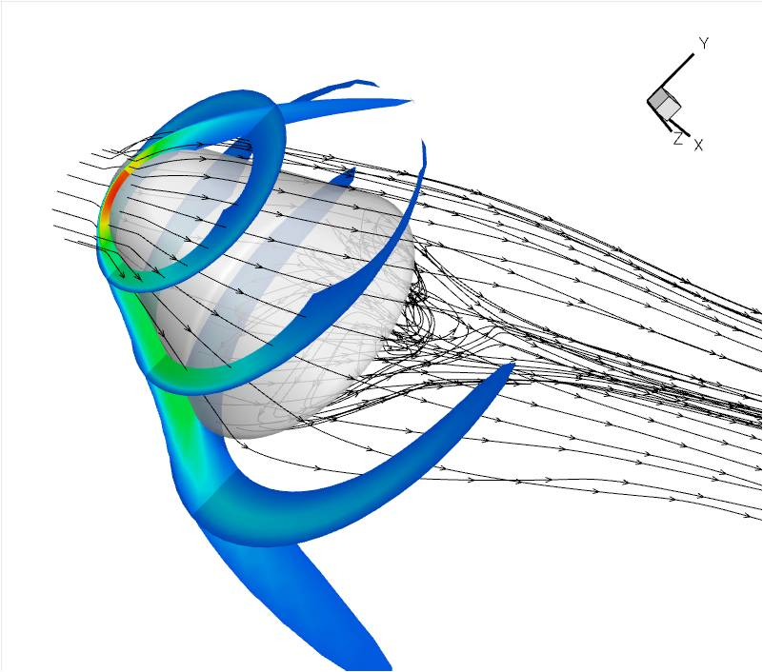
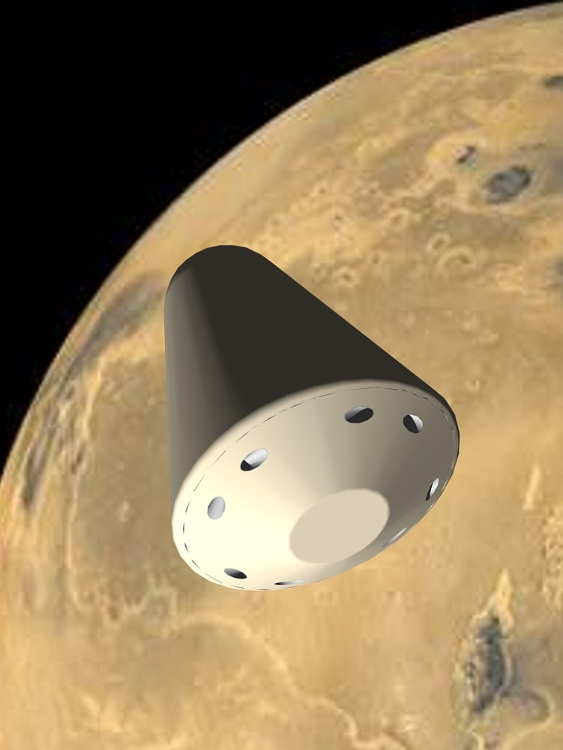
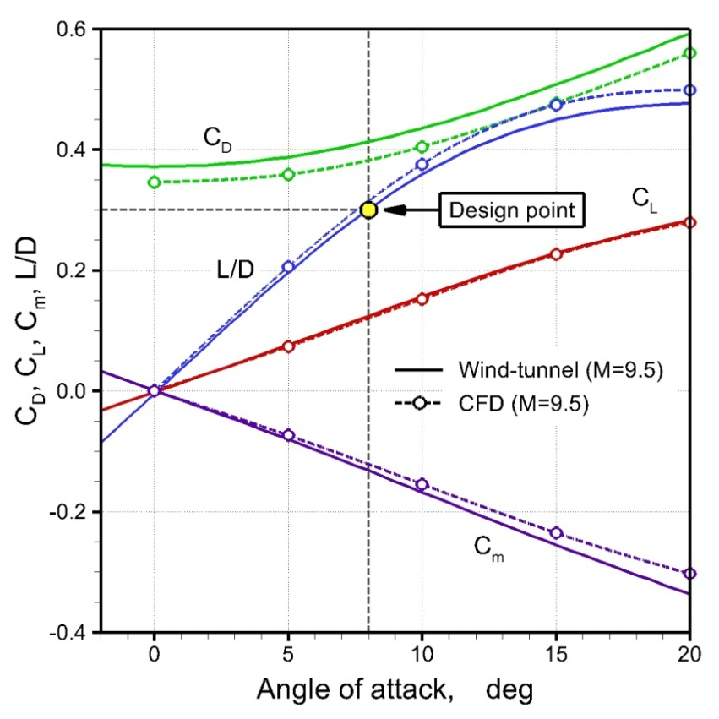
Aerodynamic Design
System requirements
  L/D > 0.3 (up to 0.4 for α < 12)
  β ≈ 700 kg/m²
  Equipped with light-weight TPS
  Equipped with RCS’s
CFD (M=9.5)
Nose radius = 0.38 m
Half cone angle = 20⁰
Base diameter = 1.63 m
Wind tunnel (M=9.5)

Slide 7
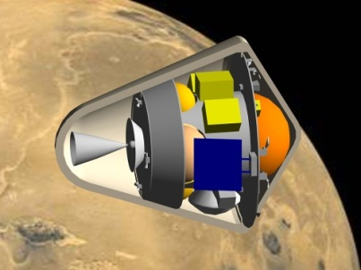
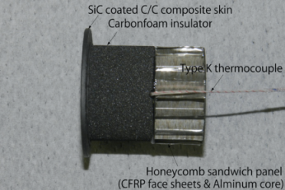
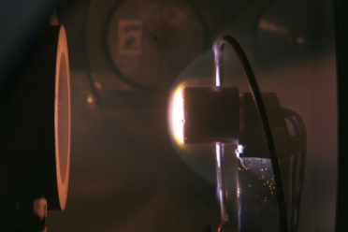
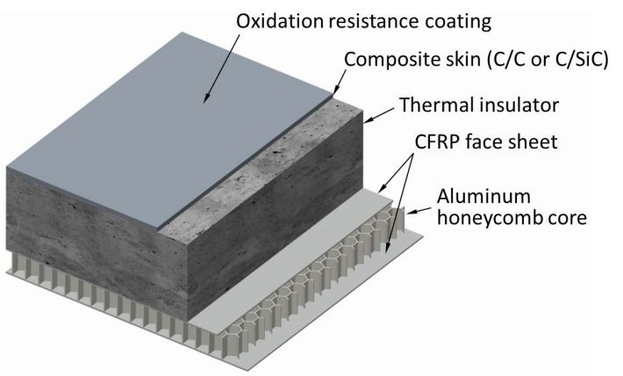
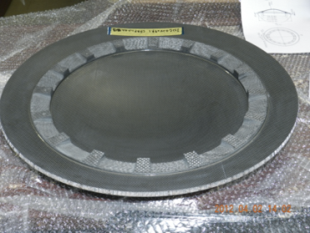
TPS Design
Development of non-ablative light-weight TPS (NALT)
  Non-ablative TPS is favorable for dust sampling during hypersonic flight
  NALT consists of C/C skin, thermal insulator, and honeycomb structure
Conceptual design of MASC aeroshell
  1D TPS analysis along a flight trajectory (search for solutions by trial-&-error method)
  Resulting in TPS area density of 9.0 kg/m² at stagnation point, 7.5 kg/m² in average, and total aeroshell mass of 133 kg
1D TPS analysis along flight trajectory

Slide 8

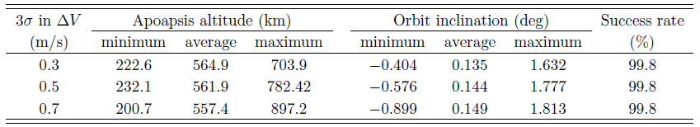
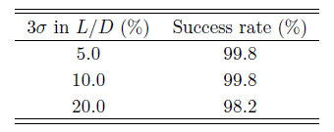
Design of GNC Subsystem
GNC subsystem configuration
  Effective descent/ascent rate control by bank-angle modulation using RCS’s
  Analytic predictor-corrector (APC) controller for primary GNC architecture
  Lateral controller to minimize lateral deviation
  Proportional–integral–derivative (PID) controller for yawing/pitching stabilization
Assessment of designed GNC controller robustness
  Monte-Carlo simulation by taking into account uncertainties in atmospheric density, aerodynamics of vehicle, orbit determination, and guidance to entry I/F point
  Results have shown sufficient robustness of designed GNC controller
  Fuel used in bank-angle modulation is minimized by optimizing RCS’s operation

Slide 9
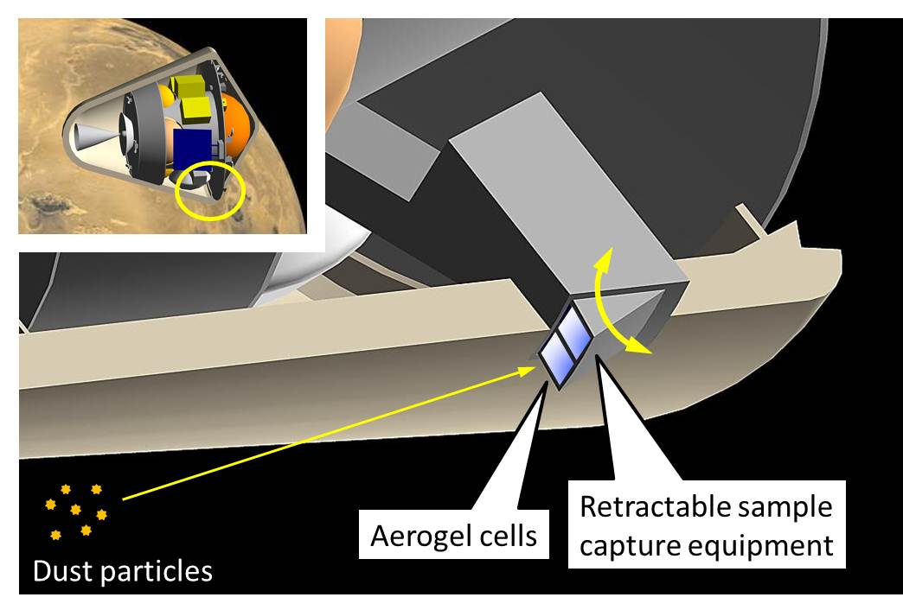
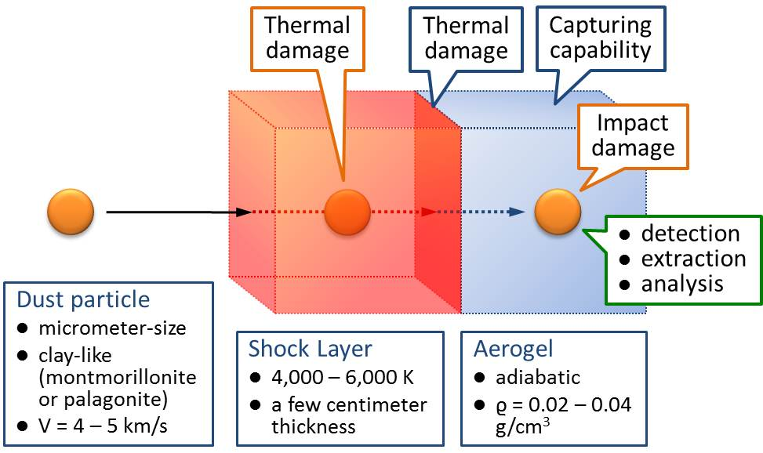
Dust Sampler Design
Approach
  Retractable samplers (currently 2) are exposed for a few seconds
  Samplers are located near aeroshell base to reduce heat transfer rate
  Silica aerogel is used for capturing sample particles (like STARDUST)
  Aerogel cells are transported to the reentry capsule inside MASC
Key issues
  Damages inflicted on dust particles by high-temperature shock layer
  Damages inflicted on aerogel exposed to high-temperature shock layer
  Dust capturing capabilities of aerogel
  damages inflicted on dust particles by impingement
  capabilities of detecting & extracting dust samples stuck in the aerogel

Slide 10
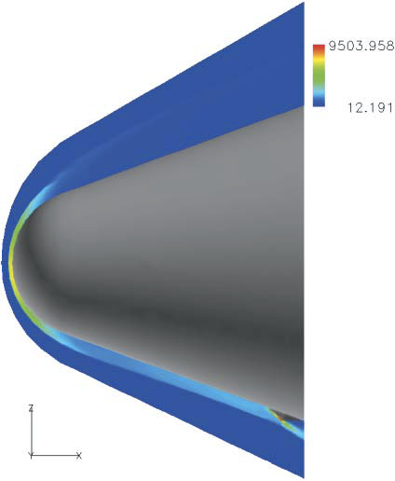
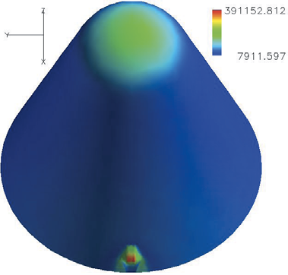
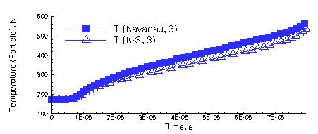
Assessment of Sample Damages
Trajectory & heat transfer analysis of sample dust particles
  Particles rush almost straightly across the shock layer and reach the aeroshell surface.
  Particle temperature remains below the critical temperature since flight time < 5 μs.
  Temperature raise can be reduced by optimizing position of the sample collector in relation to the flow around the forebody aeroshell.
Trajectory & HT analysis
Optimization of collector
location by means of CFD

Slide 11
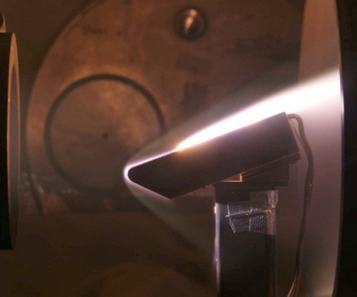
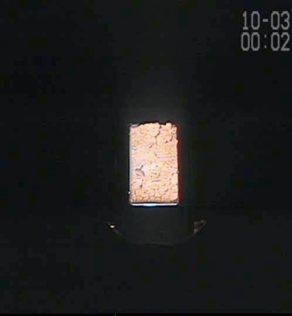
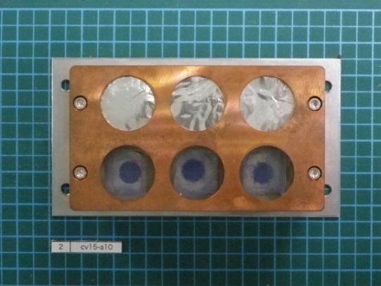
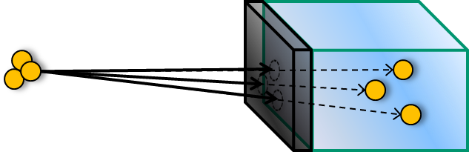
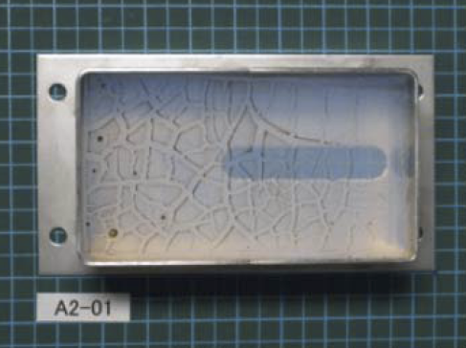
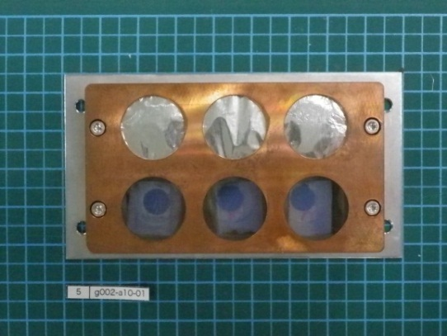
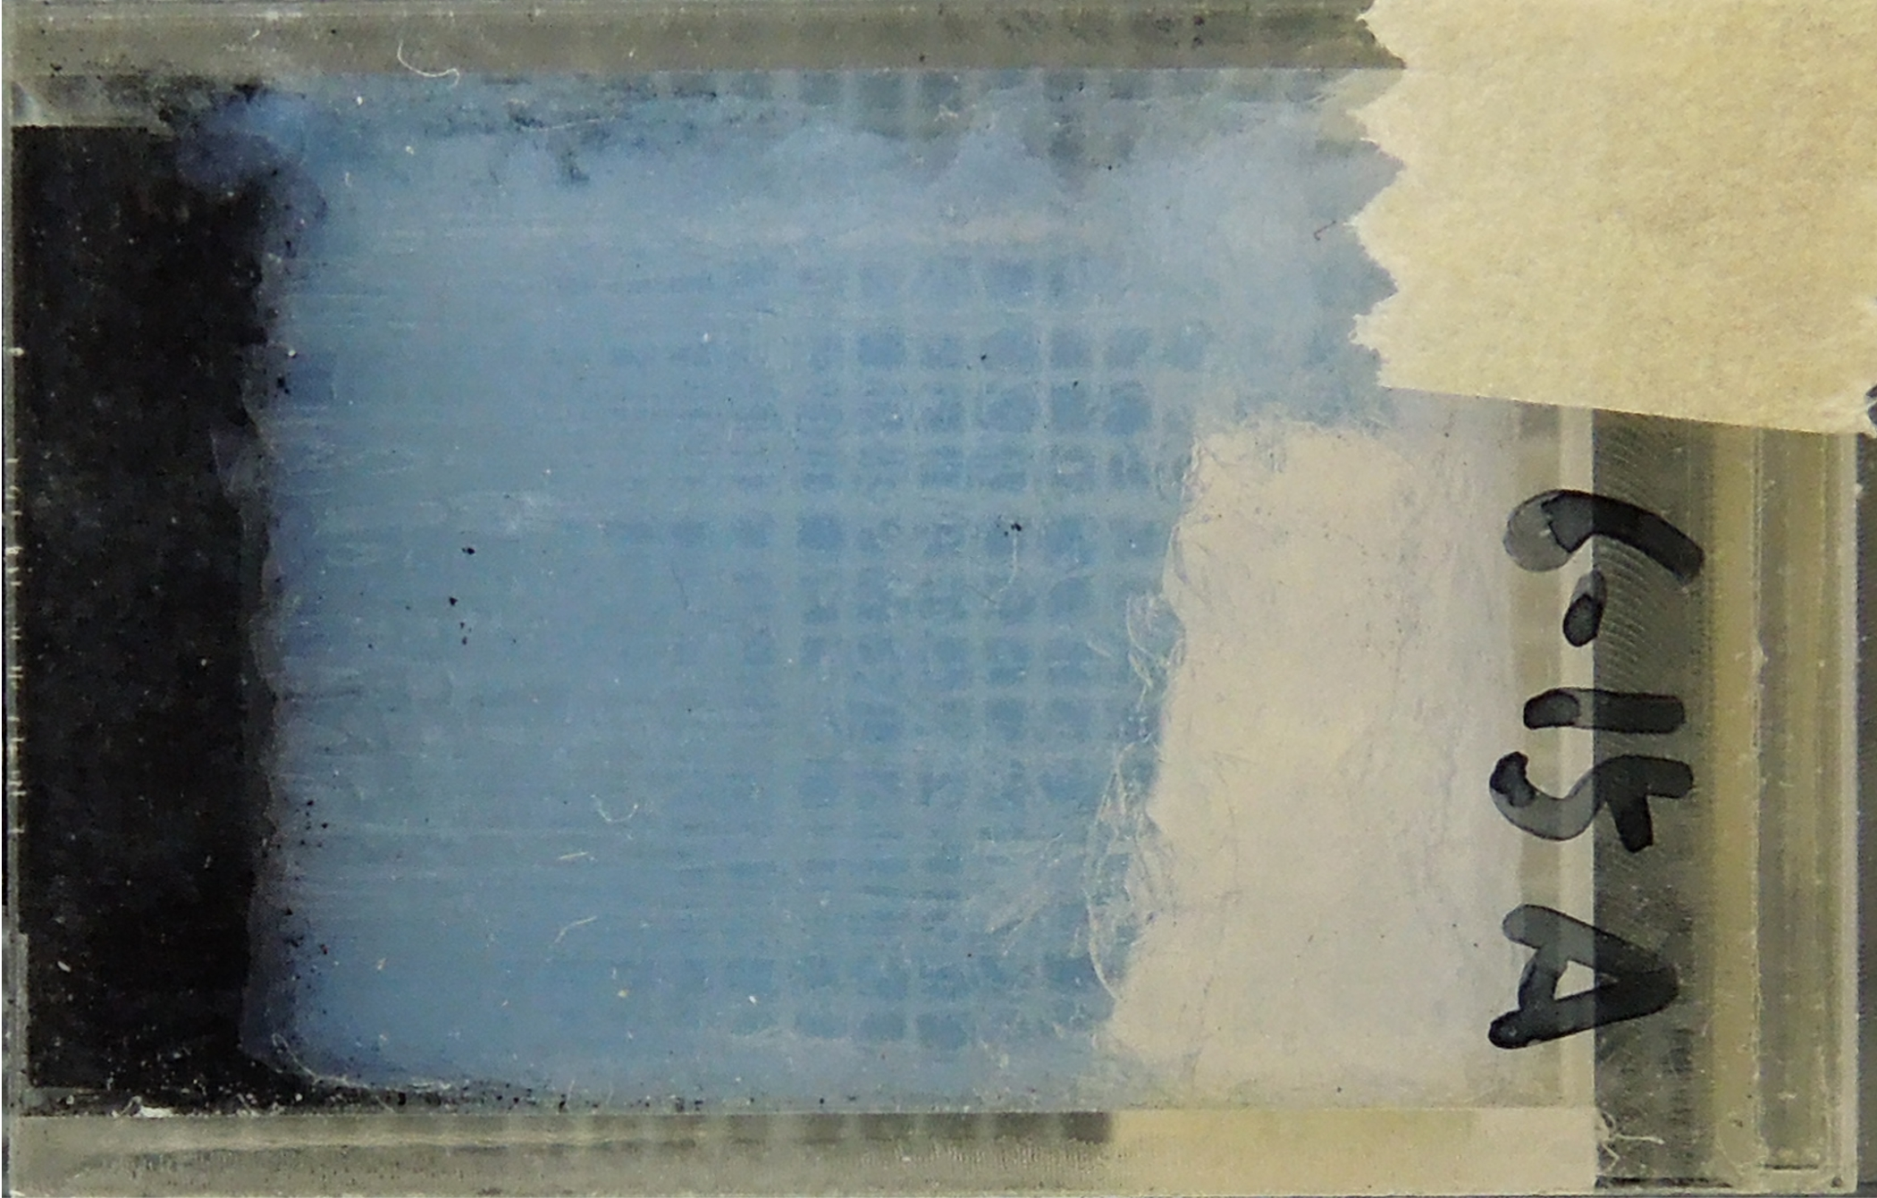
Assessment of Aerogel Damages
Arcjet heating test campaign
  1st circular : aerogel surface was vitrified to the depth of several μm & charred materials were formed on the surface by oxidation of hydrophobizing agents
  2nd circular : an aerogel cell to shore up structural strength as well as to reduce heat transfer rate was successfully demonstrated with non-hydrophobic aerogel
  3rd circular : non-silica aerogel specimens are tested to improve heat resistance
1st test campaign
2nd test campaign
3rd test campaign
Before
Carbon aerogel (CA)
CASA: CA/SA 2-layer aero-gel for higher heat-resistance
After
After
Notes:
The damages of aerogel due to contact with high-temperature gases in the shock layer have been quantitatively examined by arcjet heating tests.
Hydrophobized lump silica aerogel specimens having a 0.02, 0.03, and 0.04 g/cm³ density were tested in the arc-heated air flows in the first test campaign.
The cold-wall heat transfer rate was 0.4 MW/m², and the exposure time was varied from 1 to 3 seconds.
It was found that the aerogel surface was vitrified to the depth of several micrometers, which brought about crackle-glazed patterns on the surface.
In addition, charred materials formed by oxidation of the hydrophobizing agents were seen to be scattered on the surface.
In order to solve these problems, an aerogel cell, which has multiple capabilities of shoring up structural strength of the aerogel element and reducing the heat transfer rate on the surface, was developed and demonstrated with the aerogel without hydrophobic treatment in the second test campaign. It is seen that the damages of the aerogel are almost totally eliminated due to improvements introduced in the second test campaign.

Slide 12
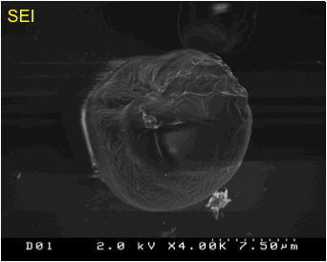
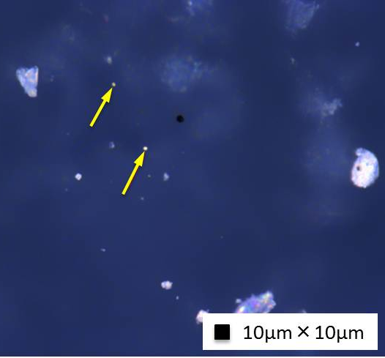
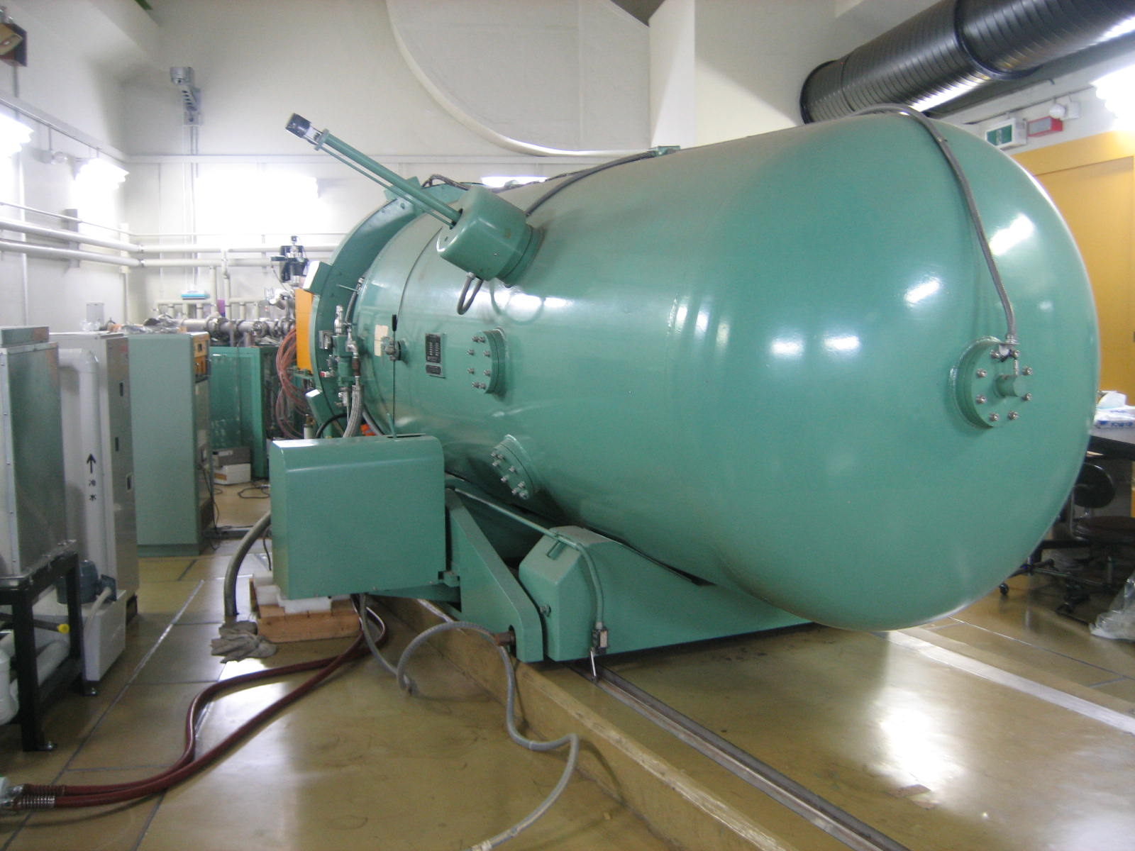
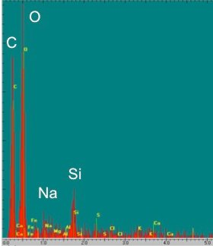
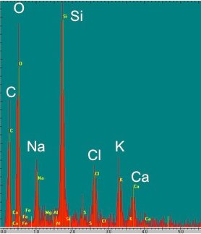
Assessment of Dust Capturing Capabilities
LGG dust capture tests (at Space Plasma Lab., ISAS)
  Alumina/montmorillonite particles of 10-30 μm in diameter were successfully captured by aerogel cells before/after arcjet-heating
  Scan, extraction, & SEM/EDS analysis of samples has been successfully demonstrated
VdG dust capture tests (at HIT)
  Argental particles of 1 μm in diameter were successfully captured by aerogel cells both before/after arcjet-heating.
SEM/EDS Analysis
(montmorillonite, 10 μm)
VdG dust capture tests
Particle surface is seen to somehow contaminated by melted aerogel.
Virgin particle
After
impingement
(×1000)

Slide 13

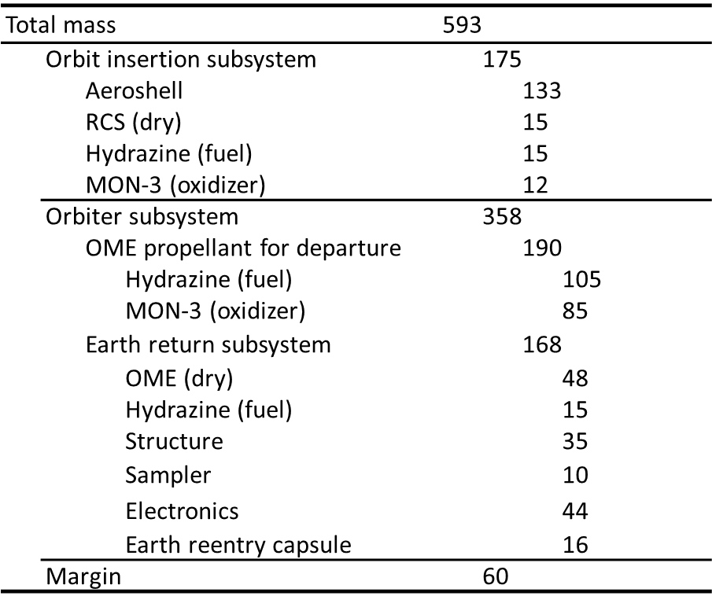
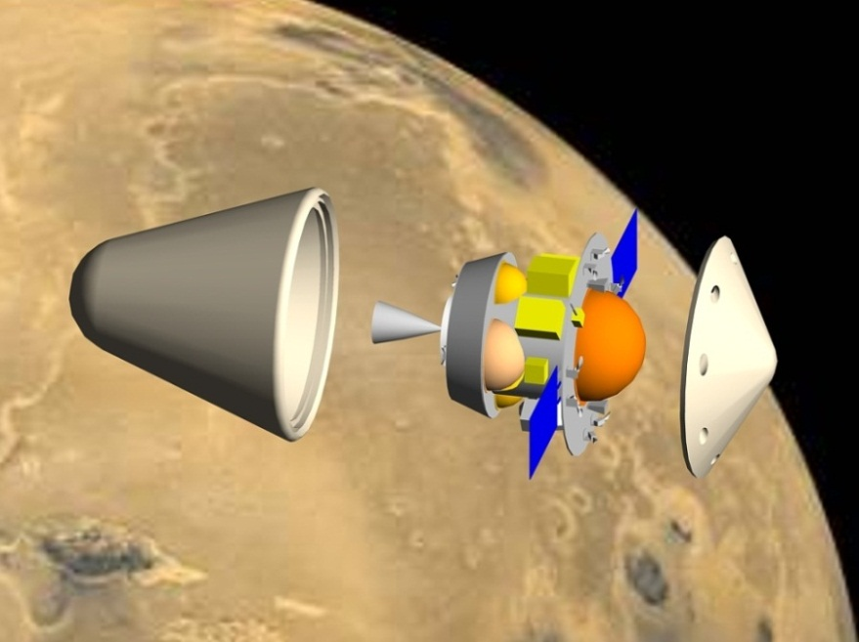
System Configuration
Conceptual system design
  Conducted based on the latest status of subsystem development, and on heritages of HAYABUSA sample return system
  Further reduction of system mass may be realized by introducing new instruments

Slide 14

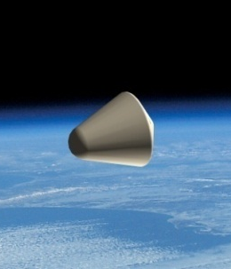
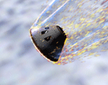
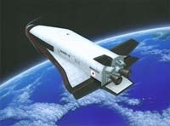
Development Plan (if applied to MELOS1)
MELOS1
Phase A
B
C
D
E (~2022)
Demonstrators
Phase A
B
C
D
E (~2019)
MELOS2 mission
~2024
MELOS Launch (2020)
MELOS CDR (2018)
MELOS PDR (2016)
Demonstrator MDR
(2012E)
MELOS MDR (2013)
MASC/MELOS1 mission
Demonstrators at Earth/Mars
Basic research & Development
~2020
~2015
~2010
Sampling demonstrator at Earth
AOT demonstrator at Mars
~2008
Front-loading phase
Light-weight aeroshell
equipped with TPS
GNC subsystem
Sample collector
Demonstrator design
TRL 8 ~ 9
Conceptual
study
Verification
in laboratory
Spin-off
Reentry system (HRV)
Reusable system
TRL 3
TRL 4 ~ 5
TRL 6 ~ 7

Slide 15
Conclusion
Mars Aeroflyby Sample Collection (MASC) using AOT technologies is proposed as a part of MELOS mission
Feasibility study of MASC has been conducted
  The trajectory calculations have shown that a wide AOT corridor acceptable for the state-of-the-art GNC technologies in planetary explorations can be achieved by use of a lifting aeroshell with L/D > 0.3.
Preliminary R & D of the MASC subsystems are in progress
  The integrated aeroshell with the TPS is designed to have a 7.5 kg/m² area density
  Robustness of developed GNC controller has been demonstrated
  Overall examinations of dust sampling & analyzing techniques have been conducted
  The dust particles are expected to reach the collector across the shock layer without fatal damages
  Silica aerogel cell is found to capture dust samples of sub-μm in diameter, regardless of heat transfer from the high-temperature gases
MASC system is feasible with a minimum total mass of 600 kg
MASC is also applicable to other missions, or even solely

